Slide 1
Virtual Learning Platform Obtaining Access to the VLP by Linking Web Applications and Educator Certification
March 2023

Slide 2
Welcome
Welcome to the Virtual Learning Platform (VLP)
The following step-by-step information will provide guidance to Users on obtaining access to the VLP by linking DESE Applications sign-in (DAS) information with Educator Certification information.

Slide 3
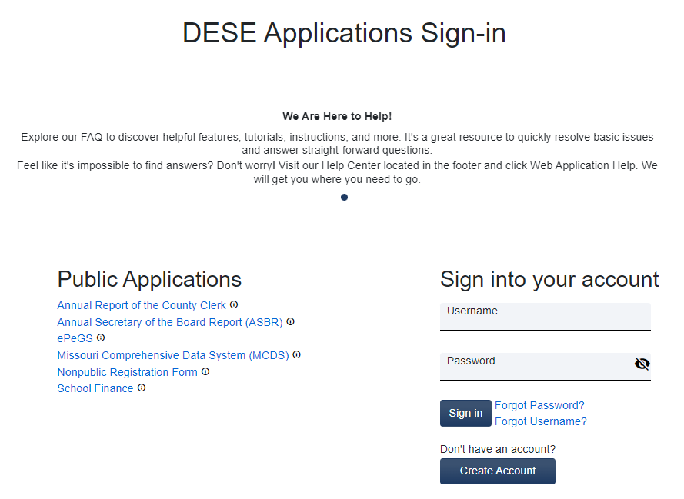
Step 1: Create an Account
If you already have a DESE Web Applications account skip to step 2.
New users need to go to the (DESE) web application site: https://apps.dese.mo.gov/weblogin/login.aspx
Then create an account by clicking the “Create Account” button. Instructions for Registering for a DESE Web Application can be viewed directly on the DESE Secured Web Application FAQ page or DESE’s YouTube page.

Slide 4
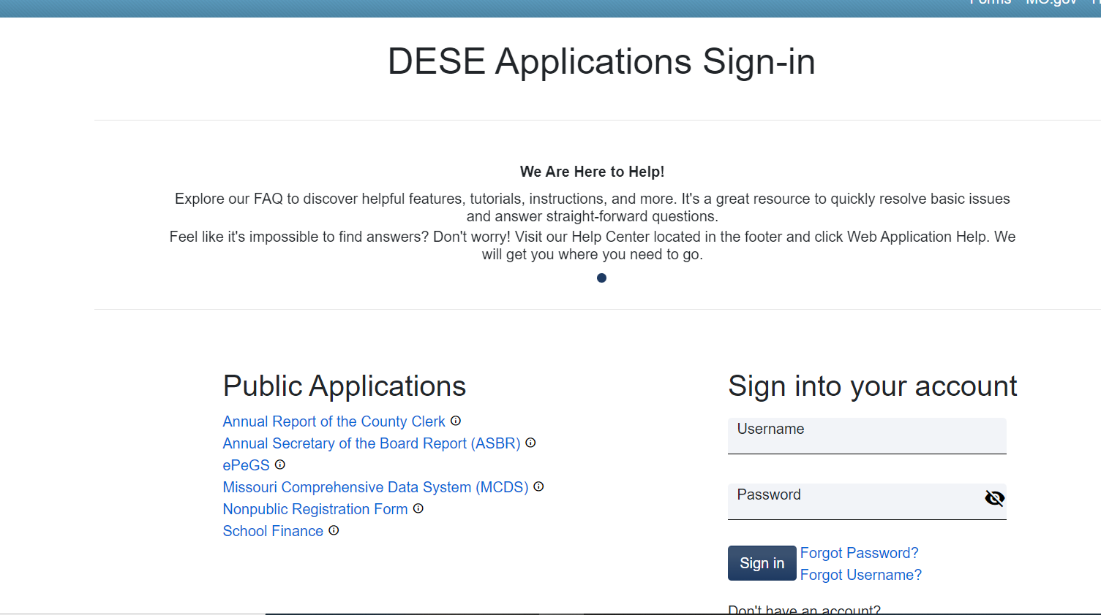
Step 2:
Log into Department of Elementary and Secondary Education’s (DESE) web application site: https://apps.dese.mo.gov/weblogin/login.aspx
Enter the user name and password, then select the Sign in button.

Slide 5
Step 3:
Select Educator Certification System – Request Educator Access from the DESE web applications list.
**Note: if your link says “Educator Certification System”, skip to Step 6.**

Slide 6
Step 4:
The next screen will be verification of the request to access the Educator Certification System. Select the submit button.

Slide 7
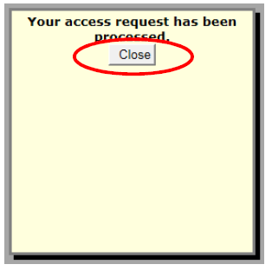
Step 5:
Select the close button. This pop-up confirms the request has been processed.
*Note: Users may need to turn off pop-up blockers if this message is not received.

Slide 8
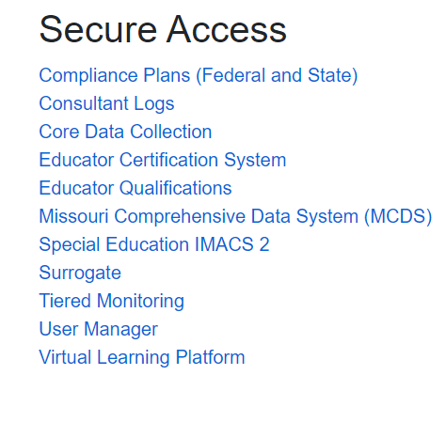
Step 6:
Select the Educator Certification System link from the DESE web applications list.

Slide 9
Step 7:
Users will need to enter their Social Security Number (SSN) number and date of birth. This is a secure step to verify the individual logging in and the profile within the Educator Certification System. Then select the submit button.

Slide 10
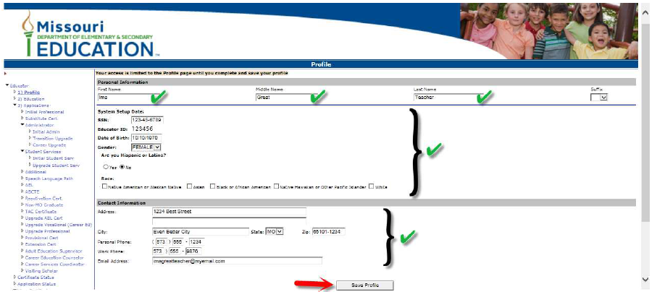
Step 8:
Verify profile information and update if necessary. Finally select the Save Profile button at the bottom of the page. This will complete the VLP registration process.

Slide 11
Once you have completed this process you should have access to the VLP if the district has granted you access. Contact your Building Administrator if the VLP is not in your DESE Applications Secure Access list.

Slide 12
Virtual Learning Platform
573-522-3489
MissouriSystemsofSupport@dese.mo.gov

