Slide 1
Virtual Learning Platform Dashboard
September 28, 2022

Slide 2
Welcome
Welcome to the Virtual Learning Platform (VLP)
The following step-by-step information will provide guidance on the dashboard within the VLP.

Slide 3
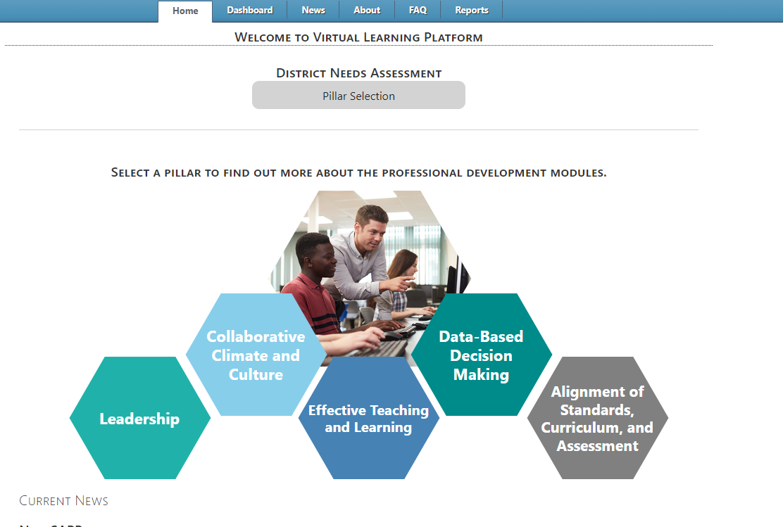
Dashboard
Upon logging in to the Virtual Learning Platform (VLP), the first landing page will be the Pillar Selection page under the “Home” tab. Navigate to the Dashboard using the tab at the top of the screen.

Slide 4
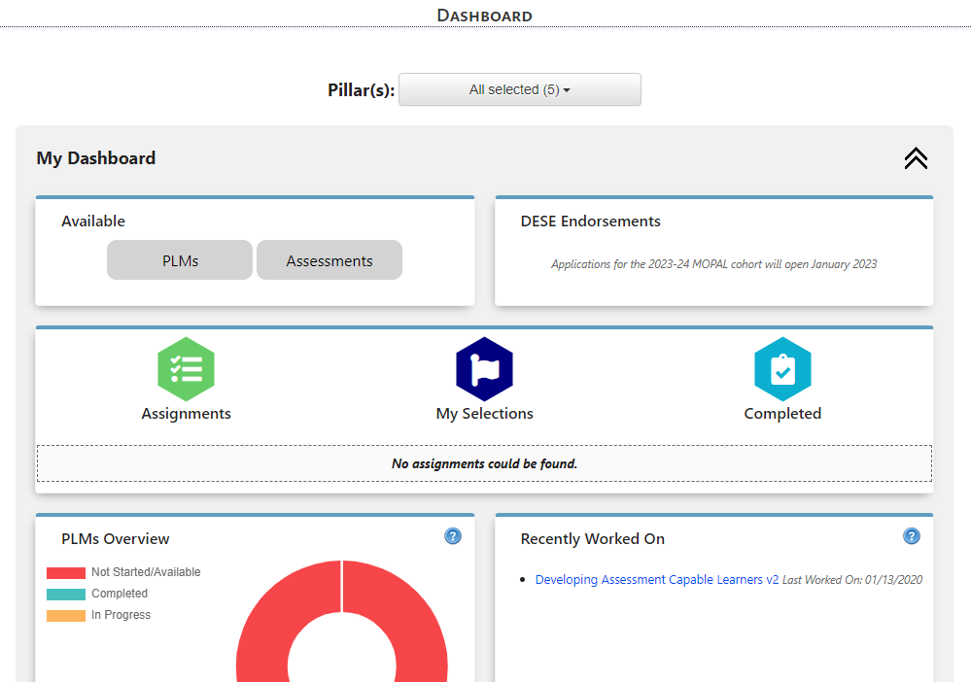
Dashboard
The Dashboard will display buttons and boxes to navigate the VLP. Including accessing, selecting and viewing progress for PLMs, and Assessments. As well as DESE Endorsement course applications.

Slide 5
PLMs Overview
Clicking on the “PLMs” button at the top of the Dashboard will navigate to the “Available Professional Learning Modules” page.

Slide 6
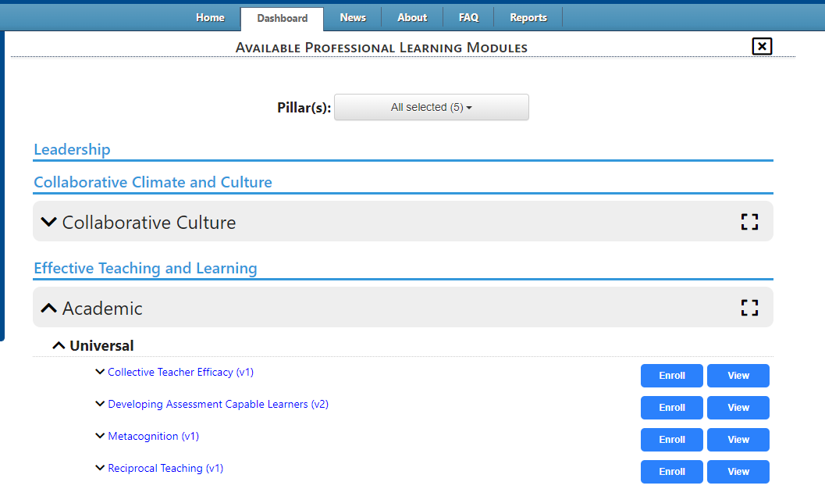
PLMs Overview
On the “Available Professional Learning Modules” page a user will see all available PLMs under each Pillar by selecting the black arrows next to the headers.
Clicking the black arrows next to the PLM name will reveal a description of the module. Click the blue “Enroll” button associated with the correct title.
Once all selections have been made. Use the black x in the upper right hand corner to return to the main page of the Dashboard.

Slide 7
PLMs Overview
When a user enrolls in a PLM from the “Available Professional Learning Modules” page it will appear on the menus under “My Selections”, and the “Recently Worked On” box next to “PLMs Overview”

Slide 8
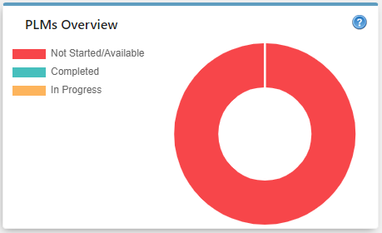
PLMs Overview
The first display box is a graphic of the Professional Learning Modules (PLM). The PLMs will be represented in the graph as the user progresses.
Red represents any PLMs that are available in the VLP that the user has not started.
Blue represents any PLMs that have been completed.
Yellow represents any PLMs that are currently being worked on, but have not been completed.

Slide 9
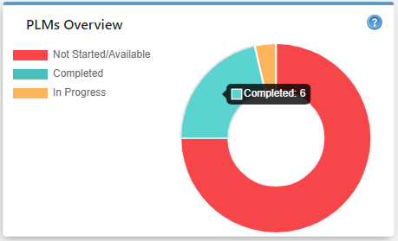
PLMs Overview
Using the cursor, hover over the color in the graph to display the PLM count associated with that color.

Slide 10
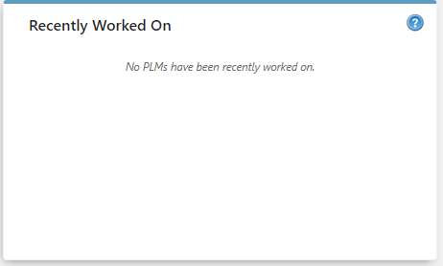
Recently Worked On-PLMs
The next display box will be the recently worked on PLMs. This box will remain blank until a PLM has been completed.

Slide 11
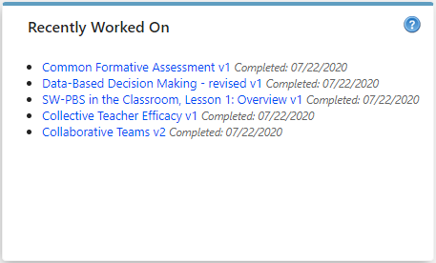
Recently Worked On-PLMs
Once a PLM has been completed, the title will display with a link to direct the page to the PLM selected. This will display the date that the PLM was completed next to the link. The recently worked on box will display up to the five most recently worked on PLMS.

Slide 12
Self-Assessments Overview
To view the assessments that are available, click the “Assessments” button at the top of the dashboard. This will bring you to the “Available Assessments” page arranged by pillar.

Slide 13
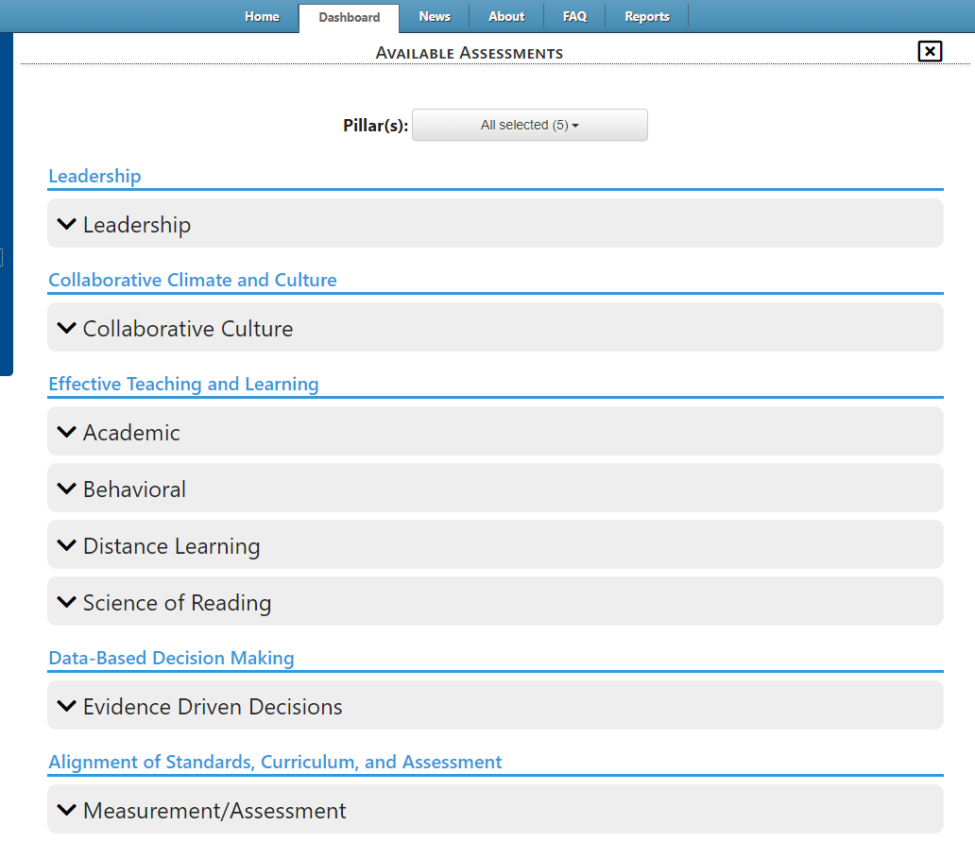
Self-Assessments Overview
Upon selection, the application will navigate to the “Available Assessments” page. Assessments are organized under the grouping headers shown below. To display the list of assessments under each grouping header, select the black arrow next to the grouping header.

Slide 14
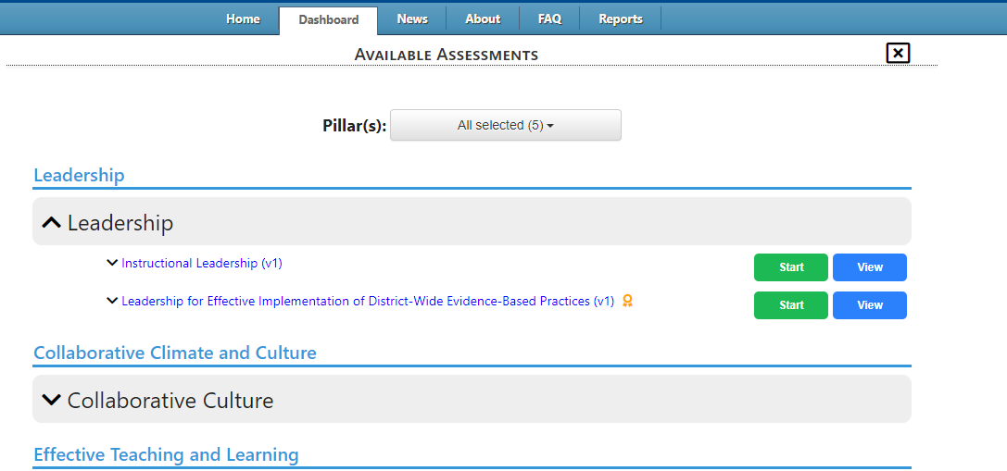
Self-Assessments Overview
After clicking on the arrow to display the assessments, there will be “Start” and “View” buttons.
By selecting “Start”, the assessment will be added to the Self-Assessment list on the “My Assessments” page, which will open once the “Start” button has been selected.
By selecting “View,” the assessment will display with the available questions, but will not be functional to submit an answer.
To read the description of the assessment click on the black arrow next to the assessment name.
To collapse the selection, use the mouse curser to click on the black arrow.

Slide 15
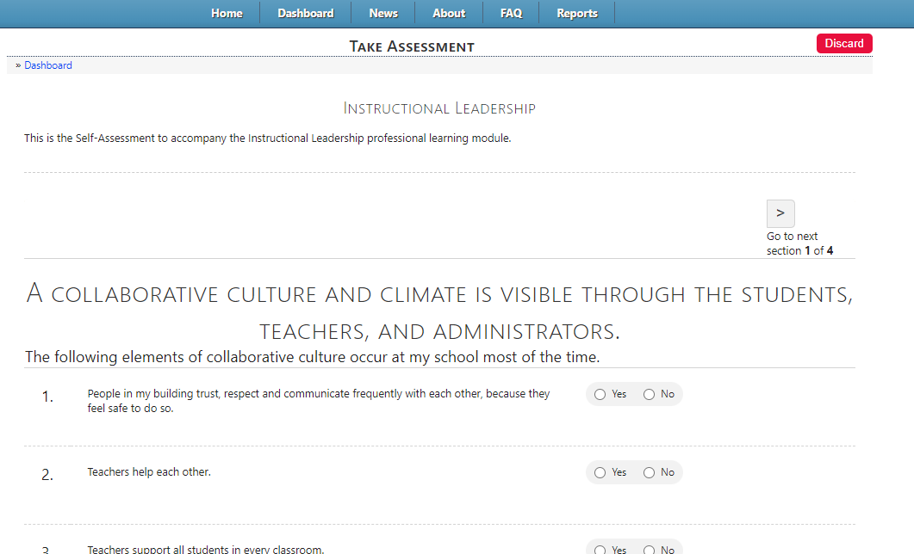
Self-Assessments Overview
When the “Start” button has been selected the application will navigate to the screen to take the assessment. Navigate back to the dashboard to view the lists.
By selecting “Start,” the assessment will be added to “My Selections” and the “Recently Worked On” list in the Self-Assessment section on the Dashboard.

Slide 16
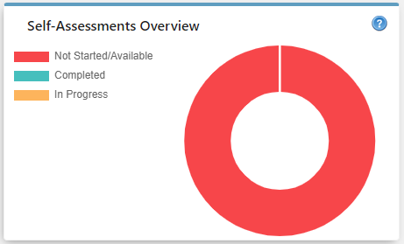
Self-Assessments Overview
The next display box is a graphic of the Self-Assessments. The assessments will be represented in the graph as the user progresses.
Red represents any assessments that are available in the VLP that the user has not started.
Blue represents any assessments that have been completed.
Yellow represents any assessments that are currently being worked on, but have not been completed.

Slide 17
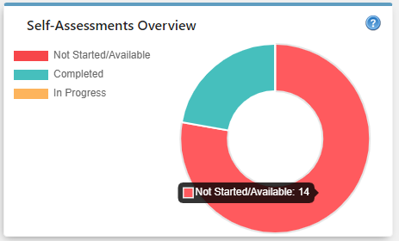
Self-Assessments Overview
Using the cursor, hover over the color in the graph to display the assessment count associated with that color.

Slide 18
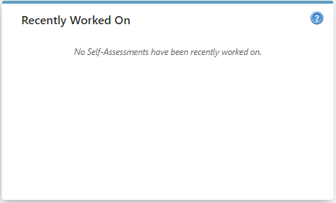
Recently Worked On-Assessments
The next display box will be the recently worked on assessments. This box will remain blank until an assessment has been started.

Slide 19
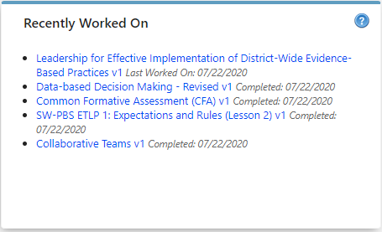
Recently Worked On-Assessments
Once an assessment has been started, the title will display a link to the assessment. The assessment page will display either a status of “Last Worked On:” if the user did not complete the assessment or “Completed” with the corresponding date that the user completed it. To continue the assessment or return to the result of a completed assessment, click the link to access the assessment. The Recently Worked On box will display up to five of the most recently worked on assessments.

Slide 20
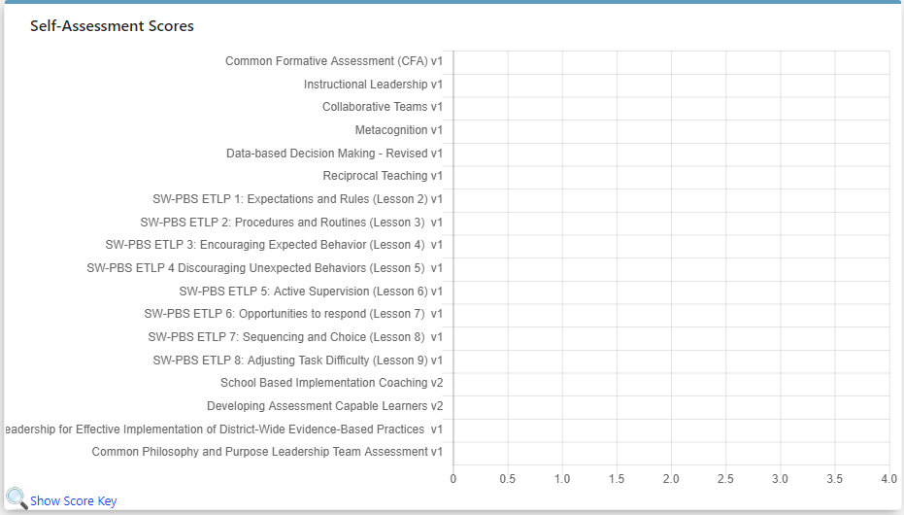
Self-Assessment Scores
Continue scrolling down the page to access the Self-Assessment Scores bar graphic. This graphic will display the most current score for the individual Self-Assessment once an assessment has been completed.

Slide 21
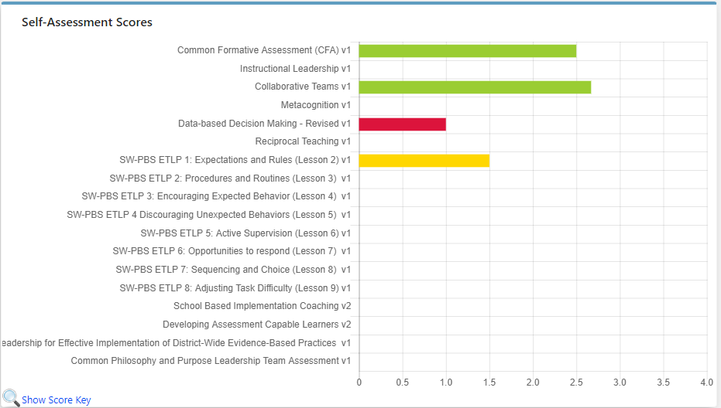
Self-Assessment Scores
The most recent score for the corresponding self-assessment will be displayed in the bar graph. The color of the bar will be reflective of the score received on the self-assessment. Blue = Exemplary, Green=Proficient, Yellow=Close to Proficient, Red=Far from Proficient.

Slide 22
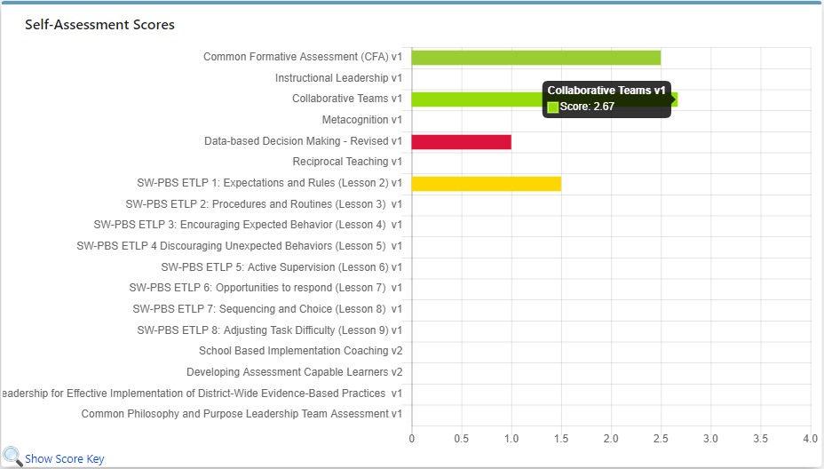
Self-Assessment Scores
To display the score for a specific assessment, use the cursor to hover over the colored bar of the corresponding assessment.

Slide 23
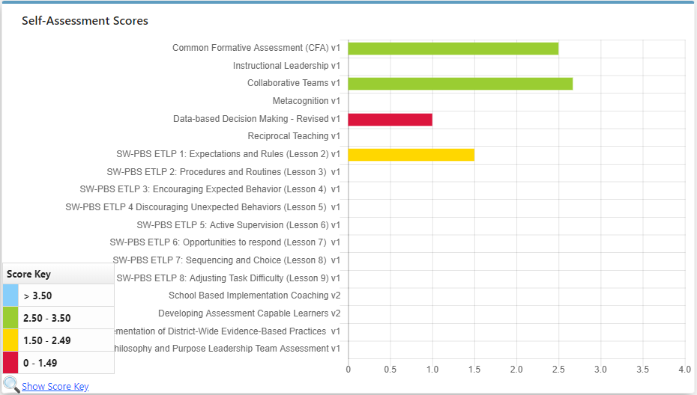
Self-Assessment Scores
To display the score key, use the cursor to hover over “Show Score Key” at the bottom of the graph.

Slide 24
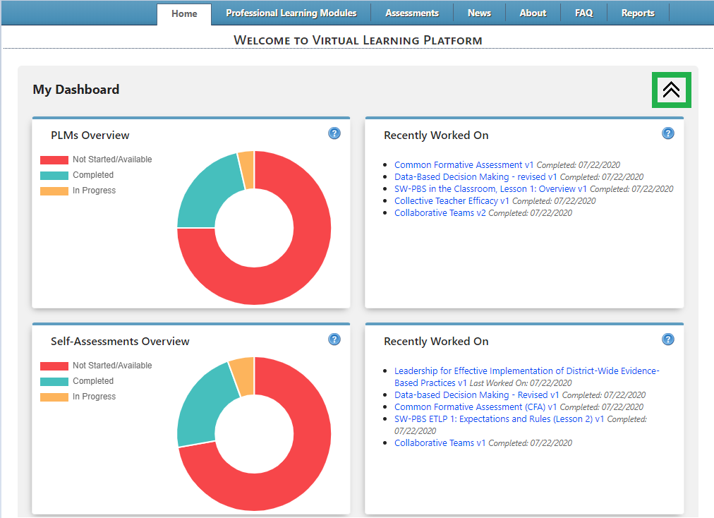
Collapsing Dashboard
To hide the dashboard, select the double arrows at the top of any section on the Dashboard page. This will collapse that specific section, but leave other sections open.

Slide 25
Collapsing Dashboard
To expand the dashboard, select the same double arrows that were selected to collapse the dashboard.

Slide 26
Virtual Learning Platform
573-522-3489
MissouriSystemofSupport@dese.mo.gov

