Slide 1
Virtual Learning Platform Assessments
September 28, 2022

Slide 2
Welcome
Welcome to the Virtual Learning Platform (VLP)
The following step-by-step information will provide guidance on completing an assessment in VLP.

Slide 3
Starting Assessments Independently
Upon logging in to the Virtual Learning Platform (VLP), the first landing page will be the “Pillar Selection” page under the “Home” tab. Select Dashboard at the top of the page.

Slide 4
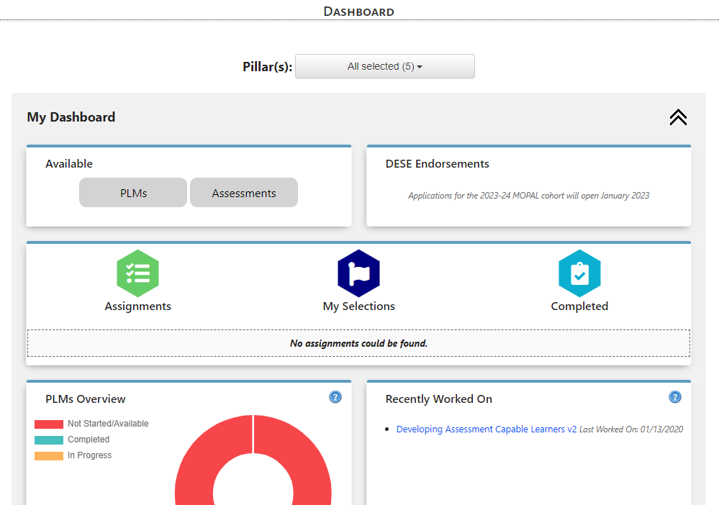
Starting Assessments Independently
To view the assessments that are available, click the “Assessments” button at the top of the dashboard. This will bring you to the “Available Assessments” page arranged by pillar.

Slide 5
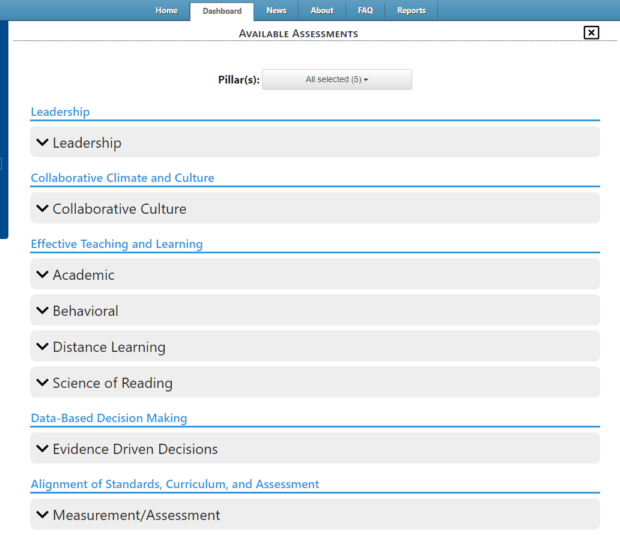
Starting Assessments Independently
Upon selection, the application will navigate to the “Available Assessments” page. Assessments are organized under the grouping headers shown below. To display the list of assessments under each grouping header, select the black arrow next to the grouping header.

Slide 6
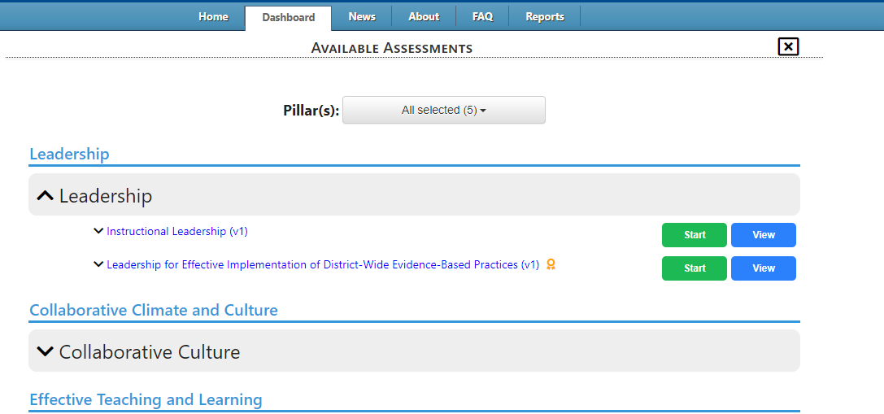
Starting Assessments Independently
After clicking on the arrow to display the assessments, there will be “Start” and “View” buttons.
By selecting “Start”, the assessment will be added to the Self-Assessment list on the “My Assessments” page, which will open once the “Start” button has been selected.
By selecting “View,” the assessment will display with the available questions, but will not be functional to submit an answer.
To read the description of the assessment click on the black arrow next to the assessment name.
To collapse the selection, use the mouse curser to click on the black arrow.

Slide 7
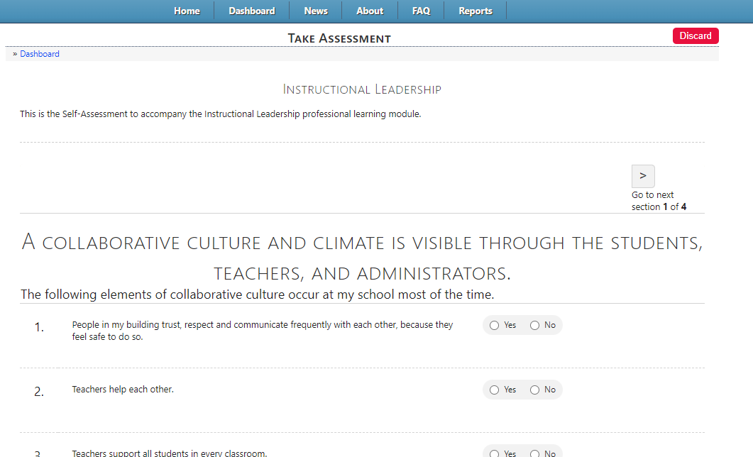
Dashboard Self-Assessments
By selecting “Start,” the assessment will be added to “My Selections” and the “Recently Worked On” list in the Self-Assessment section on the Dashboard. When the “Start” button has been selected the application will navigate to the screen to take the assessment. Navigate back to the dashboard to view the lists.

Slide 8
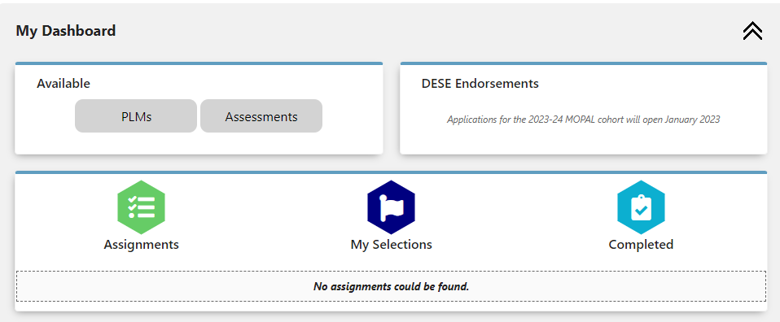
Dashboard Self-Assessments
On the dashboard to view the assessment under “My Selections” click on the hexagon with the flag. A menu will appear with both Assessments and PLMs. The menu will show the Pillar, Type, Title, Last Worked on Date, and Action.

Slide 9
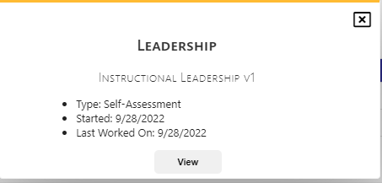
Dashboard Self-Assessments
To see the information for the assessment, click the black magnifying glass under the “Action” header with the correct assessment title. Once the magnifying glass has been selected, the information will display in a pop-up. This information includes who the assessment was assigned by (if applicable), assignment type, when the assessment was started, and when the assessment was last worked on. Clicking the “View” button will navigate to the first page of the assessment. Close the box by clicking the black “x” in the upper right hand corner.

Slide 10
Dashboard Self-Assessments
To go to the assessment select the black arrow box under Action in the correct row. A pop up dialogue box will appear at the top of the screen. Click the “OK” button to navigate to the first page of the assessment. To stay on the dashboard click the “Cancel” button.

Slide 11
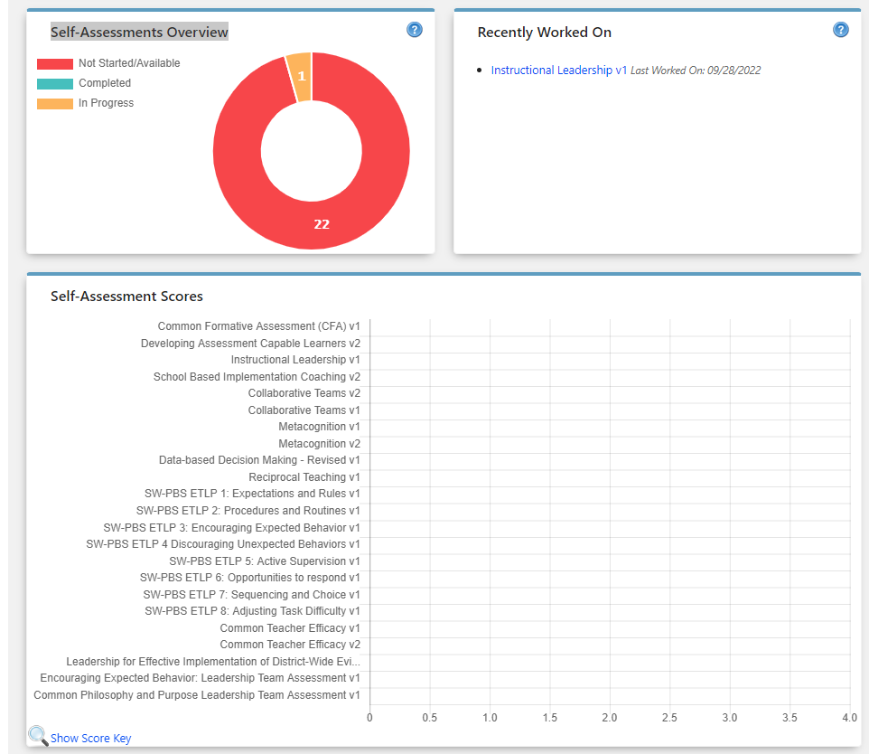
Dashboard Self-Assessments
Scroll down the Dashboard to view the Self-Assessments section.
The “Self-Assessments Overview” box, will show completed, available, and in progress assessments.
The “Recently Worked On” will show a list of the five most recent assessments as a link with a Last Worked On date.
Below that will show a list of all assessments with your scores displayed as a graph.

Slide 12
Starting Assessments Independently
To begin an assessment, click the Action link “go to assignment” with the correct assessment title from the “My Selections” menu, or by clicking on the link in the “Recently Worked On” box next to the “Self Assessments Overview”.

Slide 13
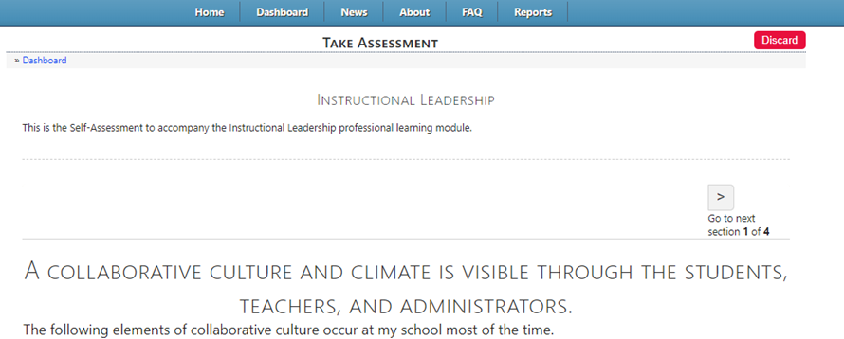
Taking Assessment
After the link is clicked, the first page of the assessment will display. Using the scroll bar, continue down the page to the questions.

Slide 14
Taking Assessment
At the top of the page is a “Discard” button. This is used if the user does not wish to take the assessment at this time and discard all answers made. Selecting “Discard” will also remove the assessment from the Self-Assessment list.

Slide 15
Taking Assessment
To stop the assessment and return to the list of assessments, select “Dashboard” at the top of the page.

Slide 16
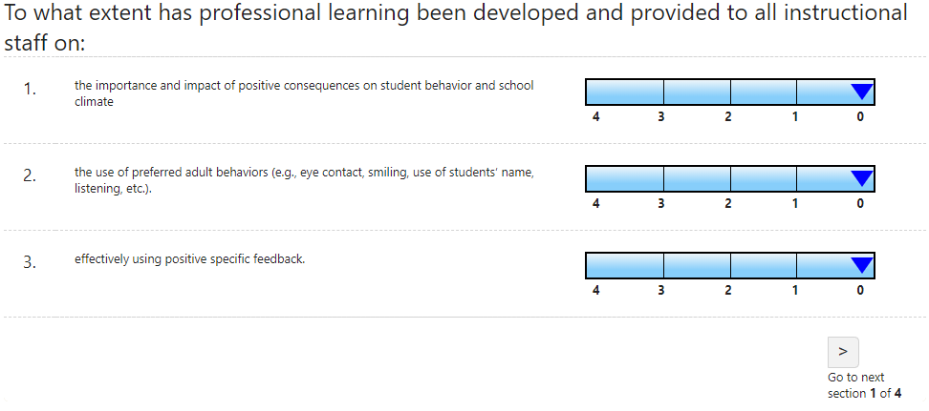
Taking Assessment
Upon scrolling, the questions to the assessment will appear. Questions in the VLP are displayed using a slide rule standard or a button selection

Slide 17
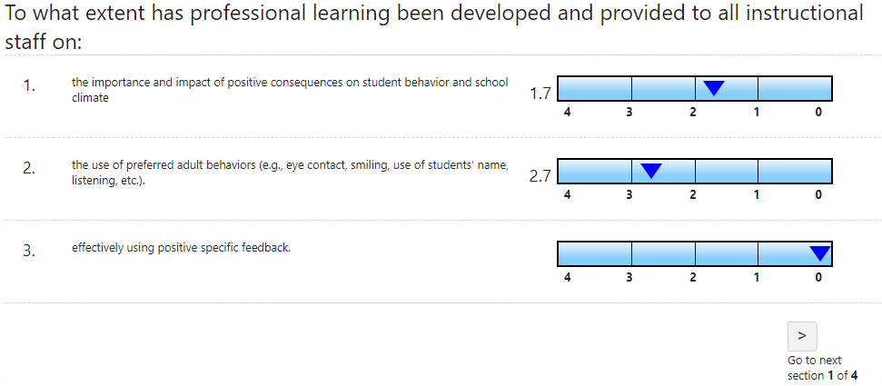
Taking Assessment
To answer on the slide-rule: Use the cursor, click the triangle to “slide” to the selection, using the scale of 4 being “Always” and 0 being “Never”.

Slide 18
Completing Assessment
When the assessment is complete, click on the “Complete Assessment” button, which is located at the top and bottom of the page.

Slide 19
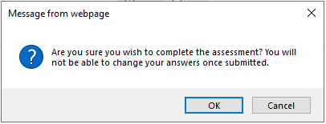
Completing Assessment
A pop up message will display on the webpage confirming that the user wishes to submit the assessment. To finish submitting, select “OK.” To return to the assessment, select “Cancel.”

Slide 20
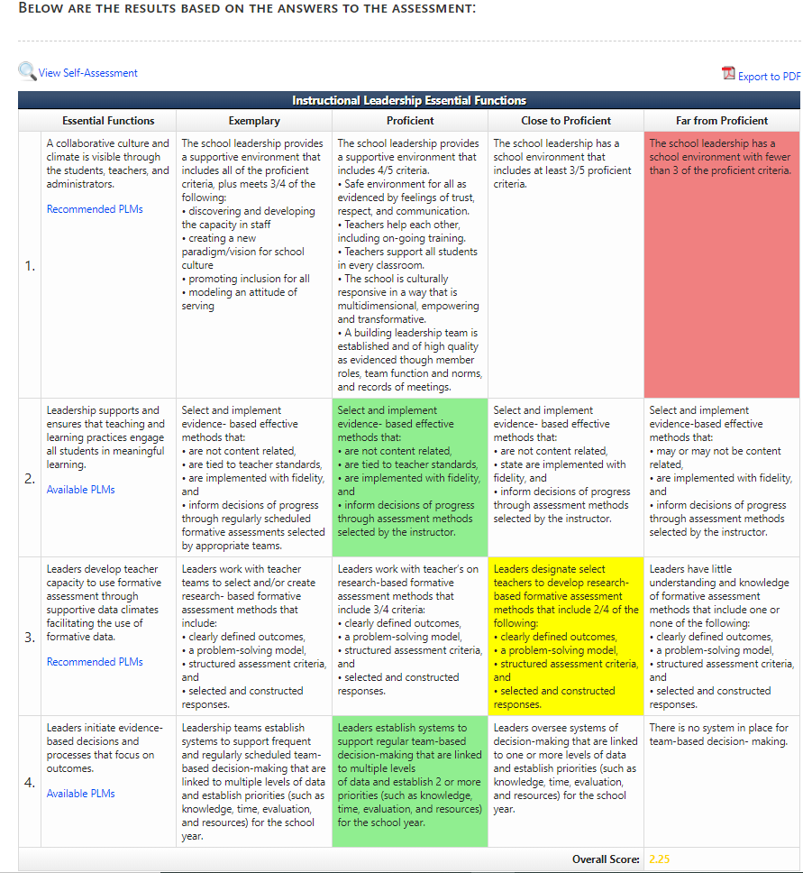
Assessment Results
After selecting “OK”, the results from the assessment will display. The results are presented in a heat map format. From the heat map, essential functions will be laid out from Exemplary to Far from Proficient. The final overall score will be presented at the bottom. In the essential function box is a hyperlink to PLMs (Professional Leaning Modules) related to the essential function. The ability to export the results to a PDF is located at the top of the page, as well as the ability to view the self-assessment again.

Slide 21
Assessment Results
The Essential Functions, the areas that are met in a successful entity, are located at the top of the page. The Essential Functions criteria are in the left column of the heat-map. Essential Functions are those functions that, when done well, will increase the likelihood of success for the entity. Essential Function scoring sections are as follows:
Exemplary- Skill exceeds expectations
Proficient- Skill meets expectations
Close to Proficient- Skill is emerging. Coaching is recommended.
Far from Proficient- Skill is not met. Follow up professional development and coaching is critical.

Slide 22
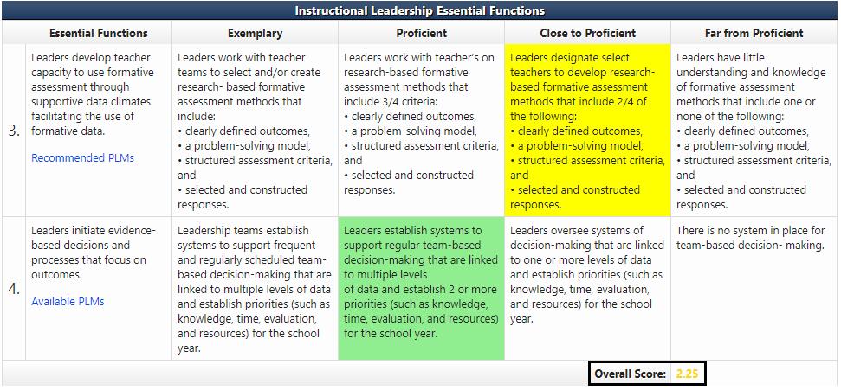
Assessment Results
The overall score will be located at the bottom of the heat map. The score will display in the corresponding color to show the Essential Function that the score lands in. The colors are as follows:
Green- Exemplary and Proficient
Yellow- Close to Proficient
Red- Far from Proficient

Slide 23
Linking to the PLMs.
Located in the Essential Functions definition box is a hyperlink to the recommended/available PLMs (Professional Learning Modules). Recommended PLMs will be presented in the Essential Function scores of Close to Proficient and lower. Available PLMs will be presented in the Essential Function scores of Proficient and above. To see the PLMs use the cursor to click the hyperlink.

Slide 24
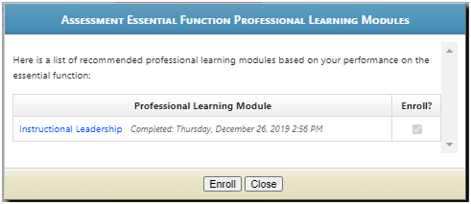
Linking to PLMs
After clicking the hyperlink, the Assessment Essential Function Professional Learning Modules will display on the screen. In the box will be the list of the PLMs linked to the Essential Function. By clicking “Enroll” you will be automatically enrolled and directed to the Professional Learning Module. To view the PLMs without enrolling, click “Close” to return to the heat map.

Slide 25
Printing Assessment Results
After returning to the heat map, click the “Export to PDF” link to print the results of the assessment. This will open the results in a PDF and will display the results with the highlighted colors, essential functions, scoring criteria and final score.

Slide 26
Viewing Completed Assessment
To view the completed assessment, with answers, select the “View Self-Assessment” link at the top of the page. This will display the assessment with the answers provided while not allowing the user to change answers.

Slide 27
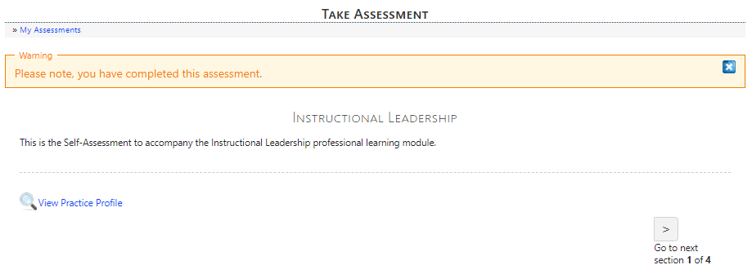
Viewing Completed Assessment
The completed assessment will display a notification at the top of the page. To return to the heat map, click on “View Practice Profile.”

Slide 28
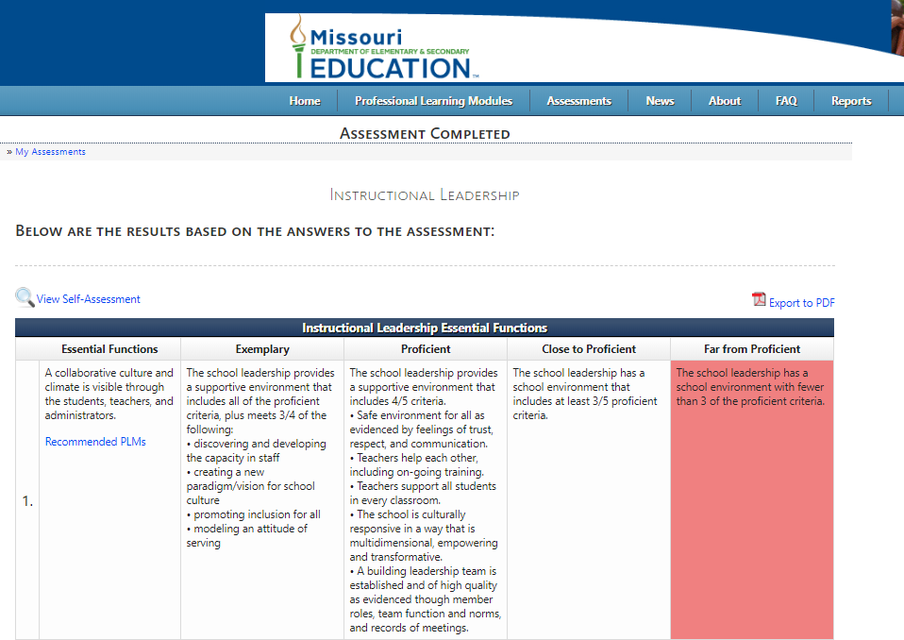
Concluding Assessment
To exit the results of the assessment, use the tabs at the top of the page to navigate to the desired page within the application.
To view Self-Assessment scores navigate back to the Dashboard and scroll to the graph in the Self-Assessments section.

Slide 29
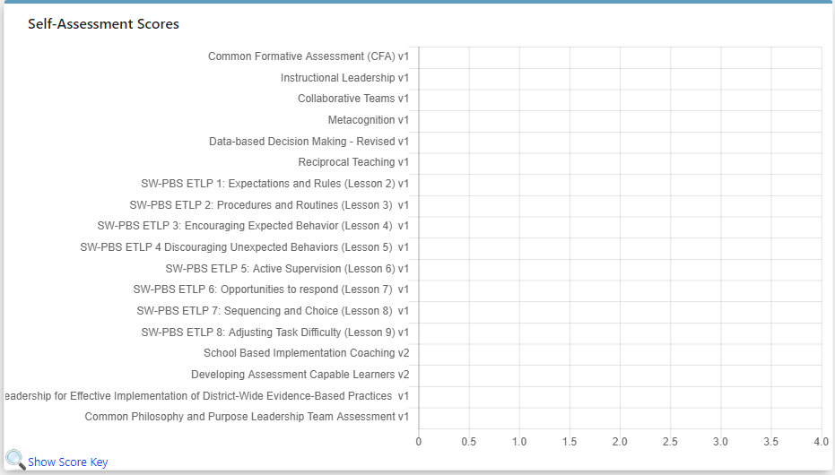
Self-Assessment Scores
Continue scrolling down the page to access the Self-Assessment Scores bar graphic. This graphic will display the most current score for the individual Self-Assessment once an assessment has been completed.

Slide 30
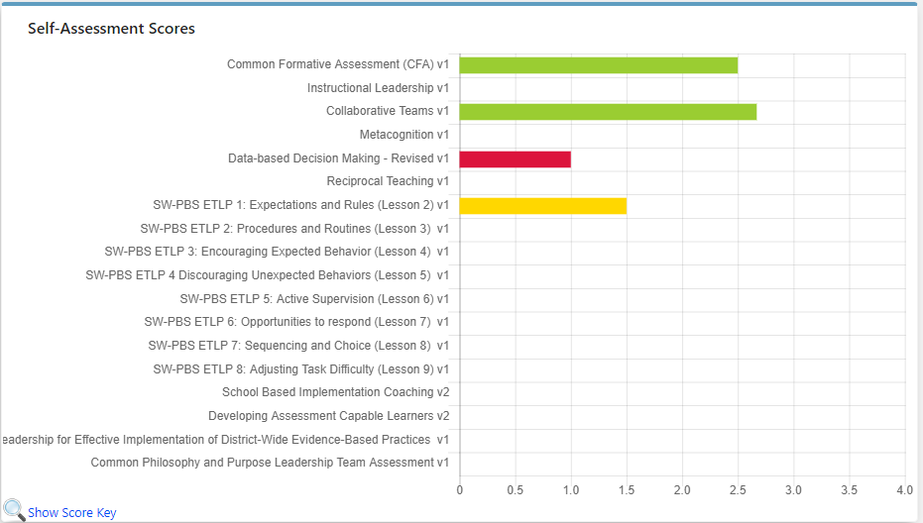
Self-Assessment Scores
The most recent score for the corresponding self-assessment will be displayed in the bar graph. The color of the bar will be reflective of the score received on the self-assessment. Blue = Exemplary, Green=Proficient, Yellow=Close to Proficient, Red=Far from Proficient.

Slide 31
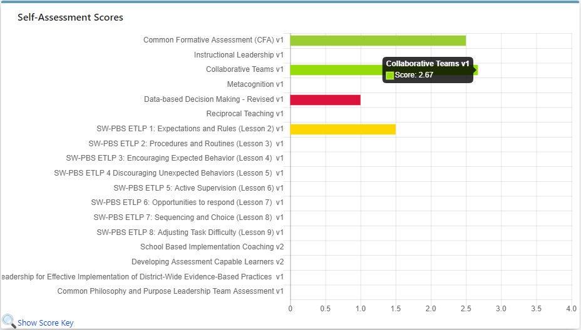
Self-Assessment Scores
To display the score for a specific assessment, use the cursor to hover over the colored bar of the corresponding assessment.

Slide 32
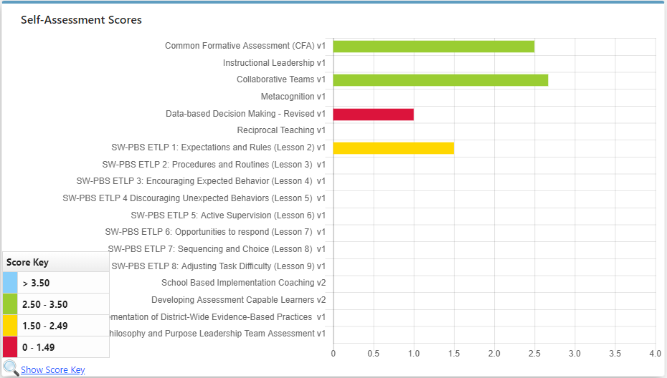
Self-Assessment Scores
To display the score key, use the cursor to hover over “Show Score Key” at the bottom of the graph.

Slide 33
Virtual Learning Platform
573-522-3489
MissouriSystemofSupport@dese.mo.gov

