Slide 1
Virtual Learning Platform Professional Learning Modules
September 28, 2022

Slide 2
Welcome
Welcome to the Virtual Learning Platform (VLP)
The following step-by-step information will provide guidance on completing a Professional Learning Module in the Virtual Learning Platform.

Slide 3
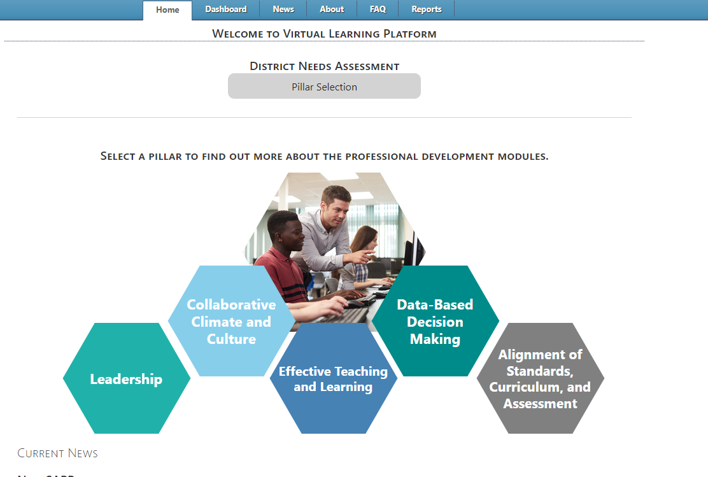
Dashboard
Upon logging in to the Virtual Learning Platform (VLP), the first landing page will be the Pillar Selection page under the “Home” tab. Navigate to the Dashboard using the tab at the top of the screen.

Slide 4
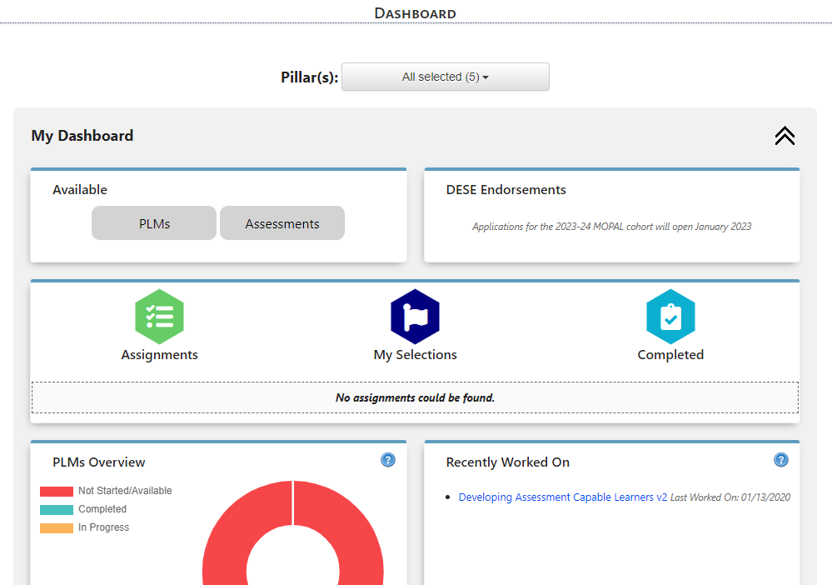
Starting Professional Learning Modules Independently
To view the Professional Learning Modules (PLMs) that are available, click the PLMs button at the top of the dashboard. This will navigate to “Available Professional Learning Modules” page.

Slide 5
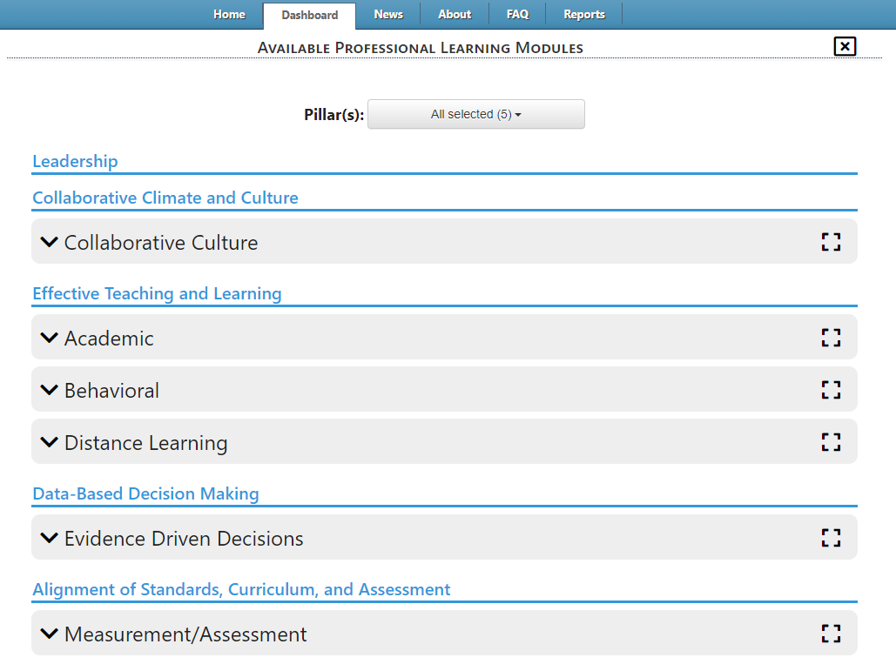
Starting Professional Learning Modules Independently
On the “Available Professional Learning Modules” page modules are organized under the grouping headers shown below. To display the list of modules under each grouping header, select the black arrow next to the grouping header.

Slide 6
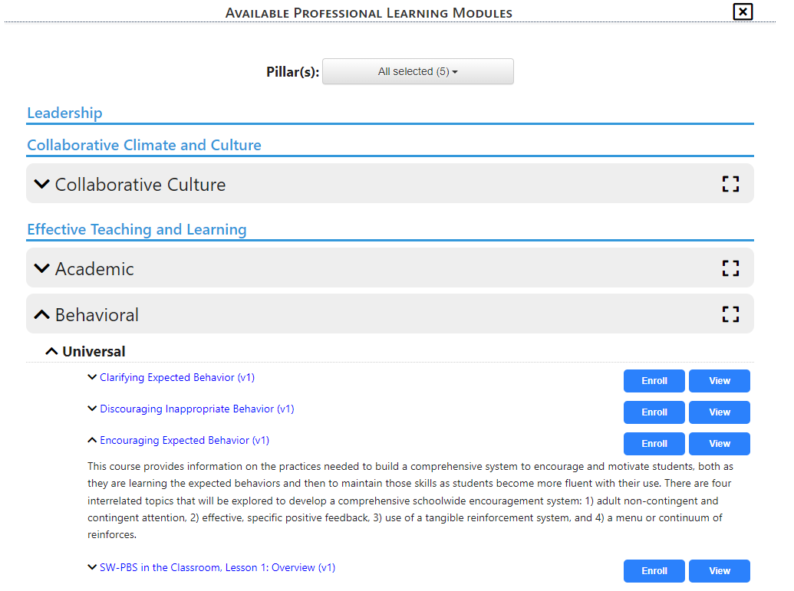
Starting Professional Learning Modules Independently
Clicking the black arrows next to the PLM name will reveal a description of the module. To collapse the description click on the black arrow again.

Slide 7
Starting Professional Learning Modules Independently
To view the PLM without making changes to the course select the “View” button.

Slide 8
Starting Professional Learning Modules Independently
To enroll and take the PLM Click the blue “Enroll” button associated with the correct title.
The buttons will change, clicking start will take the user to the first page of the PLM. Select the Dashboard tab to navigate back.
Once all selections have been made. Use the black “x” in the upper right hand corner to return to the main Dashboard.

Slide 9
Starting Professional Learning Modules Independently
When a user enrolls in a PLM from the “Available Professional Learning Modules” page and clicks “Start” it will appear on the menus under “My Selections”, and the “Recently Worked On” box next to “PLMs Overview”

Slide 10
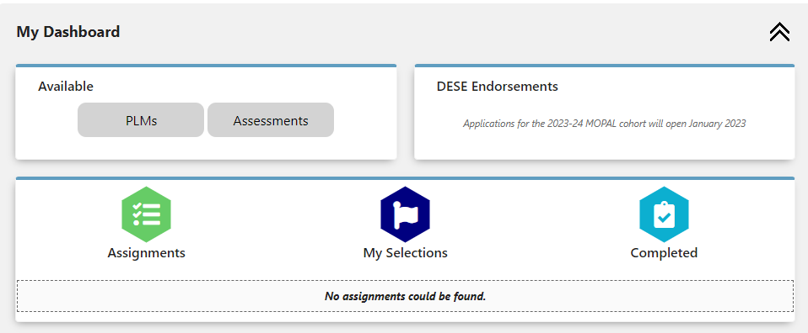
Starting Professional Learning Modules Independently
On the dashboard to view the PLM under “My Selections” click on the hexagon with the flag. A menu will appear with both Assessments and PLMs. The menu will show the Pillar, Type, Title, Last Worked on Date, and Action.

Slide 11
Starting Professional Learning Modules Independently
To see the information for the PLM, click the black magnifying glass under the “Action” header with the correct PLM title. Once the magnifying glass has been selected, the information will display in a pop-up. This information includes who the PLM was assigned by (if applicable), assignment type, when the PLM was started, and when the PLM was last worked on. Clicking the “View” button will navigate to the first page of the PLM. Close the box by clicking the black “x” in the upper right hand corner.

Slide 12
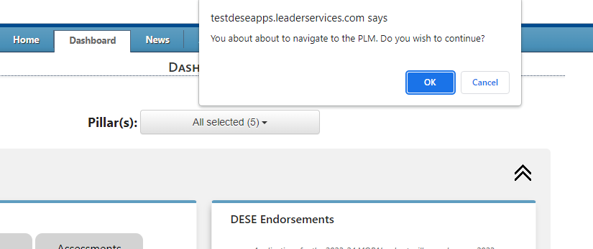
Starting Professional Learning Modules Independently
To go to the PLM select the black arrow box under the “Action” header in the correct row. A pop up dialogue box will appear at the top of the screen. Click the “OK” button to navigate to the first page of the assessment. To stay on the dashboard click the “Cancel” button.

Slide 13
Starting Professional Learning Modules Independently
On the Dashboard a PLM can also be viewed and accessed by scrolling down to the PLMs Overview section and clicking the link in the “Recently Worked On” box. Only the five most recent PLMs that have been worked on will be displayed in this list.

Slide 14
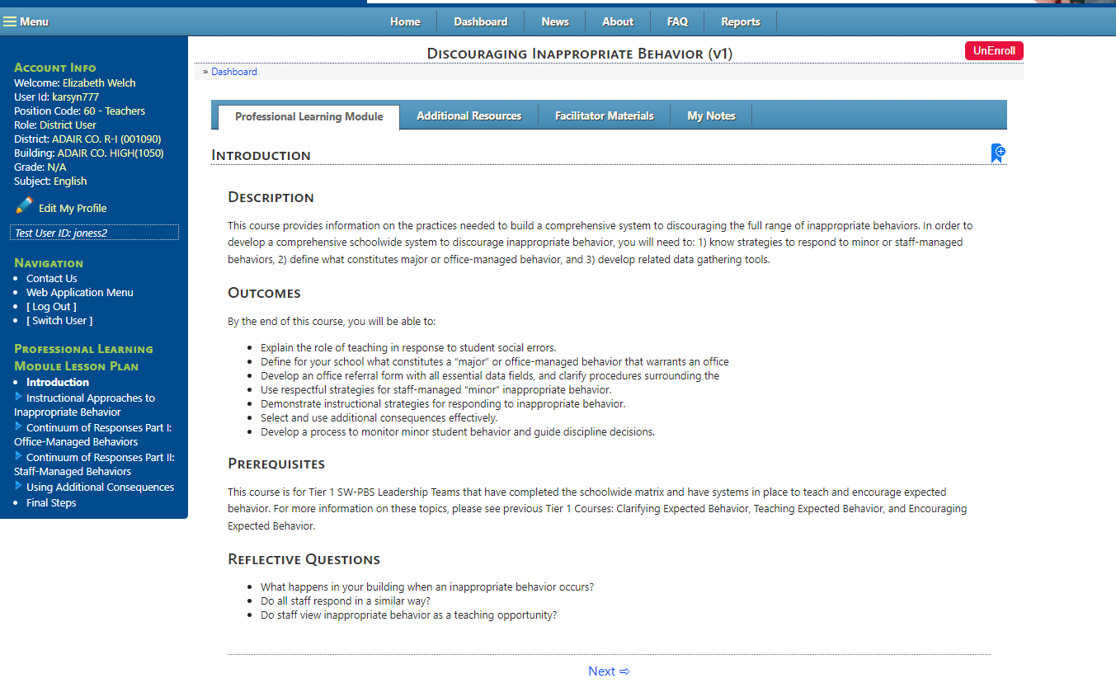
Professional Learning Modules
After the link is clicked, the first page of the PLM will display.

Slide 15
Professional Learning Modules
At the top of the page is an “UnEnroll” button. This is used if the user does not wish to complete the PLM at this time and discard all progress made. Selecting “UnEnroll” will also remove the PLM from the “My Selections” list.

Slide 16
Professional Learning Modules
To stop the PLM and return to the list of PLMs, select “Dashboard” at the top of the page or “Home” tab.

Slide 17
Professional Learning Modules
To navigate through the PLM in order, scroll to the bottom of the page and select the “Next button.

Slide 18
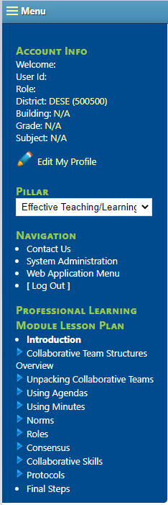
Professional Learning Modules
The second option for navigating through the PLM is by using the left navigation bar. To jump to another place in the PLM, select the title on left navigation. The title will appear bold once it has been selected to allow the user to view their location within the PLM.

Slide 19
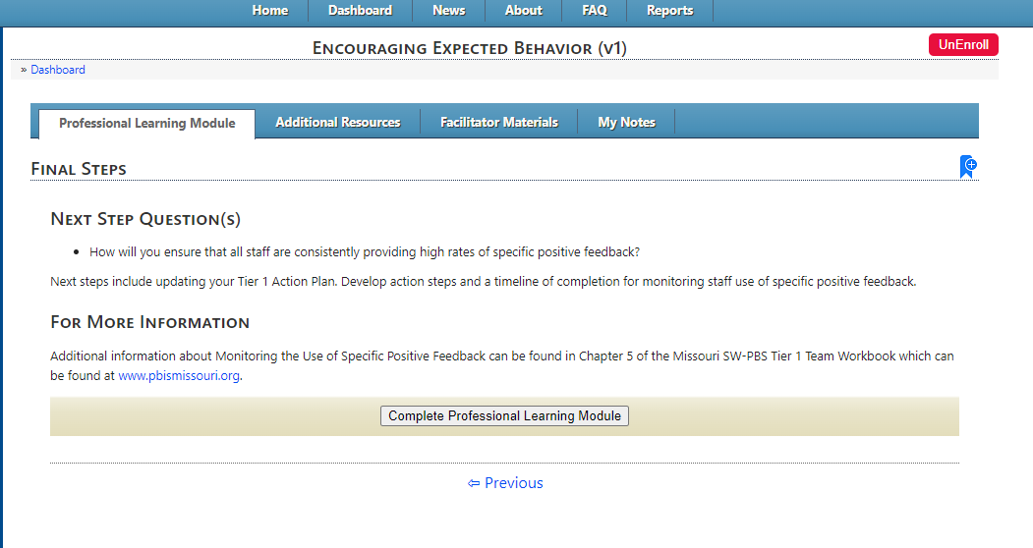
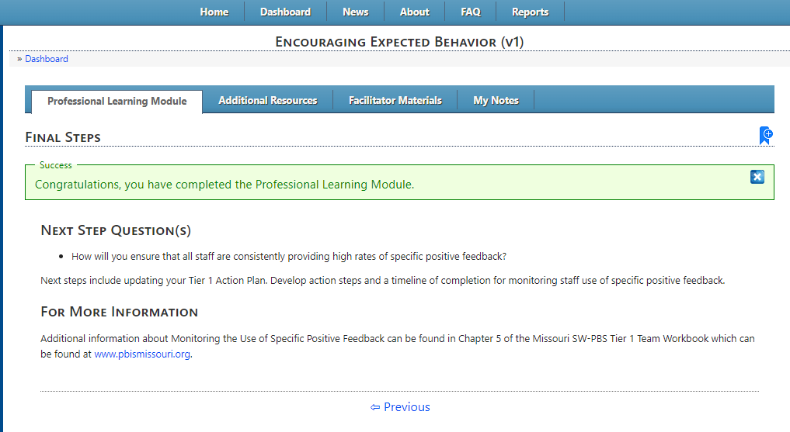
Completing Professional Learning Modules
Once the user has come to the final page of the PLM, click the “Complete Professional Learning Module” to complete the PLM, record progress, and completion. There will be a message saying it has been successfully completed. Once the PLM has been complete, users will still be able to access the PLM and resources within.

Slide 20
Completing Professional Learning Modules
At the top of the page are additional tabs for resources related to the PLM.
Professional Learning Module- the current PLM the user navigates.
Handouts & Tools- A variety of documents to better support specific PLM sections.
Additional Resources- A list of additional resources used to compile the PLM
Facilitator Materials- Additional tools to aid facilitators with assisting professional development
My Notes- Users may make any notes regarding the PLM and keep that information under the My Notes tab.

Slide 21
Completing Professional Learning Modules
To return to the Professional Learning Modules list, click the “Dashboard” link or use the “Home” tab at the top of the page.

Slide 22
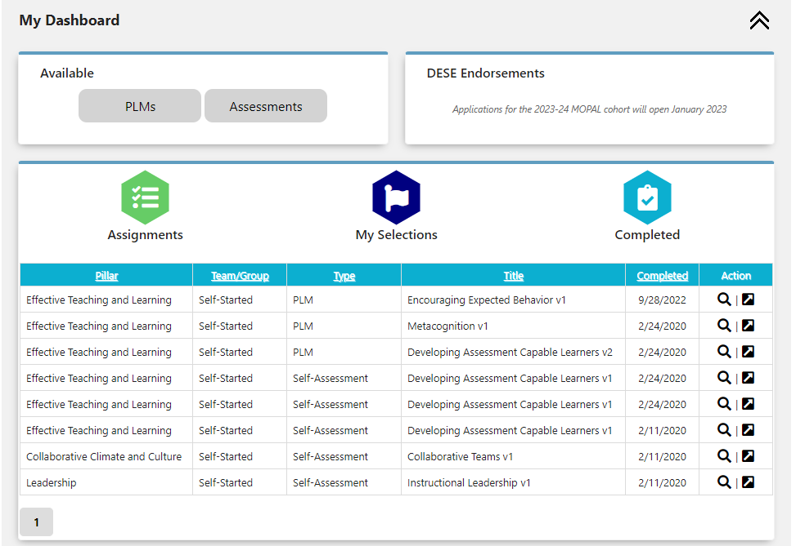
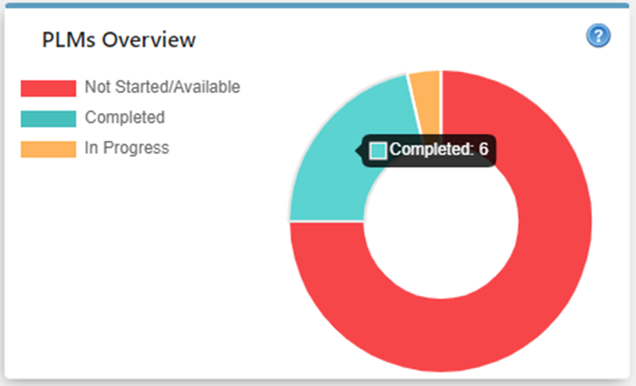
Completing Professional Learning Modules
Upon selecting “Dashboard”, the application will navigate to the “Dashboard” page. If completed, the PLM will appear in the menu under the “Completed” hexagon.
It will also be recorded in the PLMs overview box.
Once the PLM is complete, it is suggested to start the corresponding assessment.

Slide 23
Virtual Learning Platform
573-522-3489
MissouriSystemofSupport@dese.mo.gov

