Slide 1
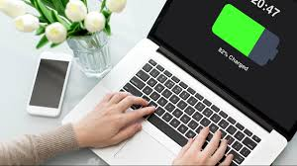
Welcome to the Virtual Learning Platform (VLP)
Virtual
Learning Platform (VLP)
User Guide
May 2023
Version 3

Slide 2
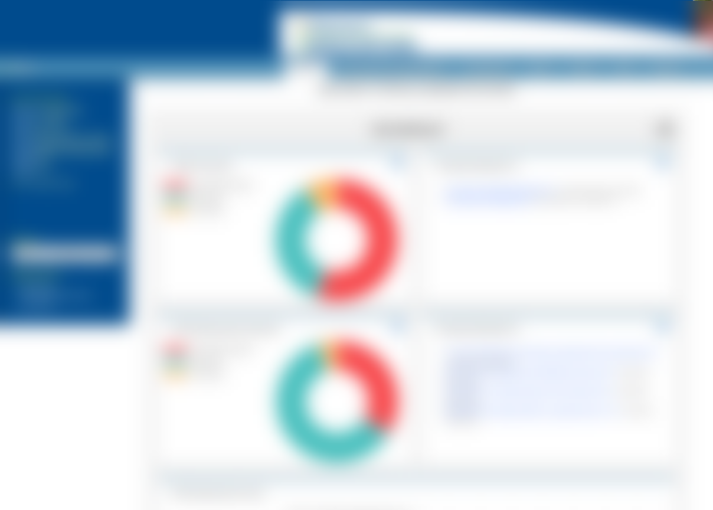
VLP User Guide
Table of Contents:
Navigating to VLP
Editing User Profile
Navigation
VLP Homepage
Accessing Pillars
Understanding the Dashboard
Professional Learning Modules (PLMs) Overview
Recently Worked on PLMs
Self-Assessments Overview
Recently Worked on Self-Assessments
Self Assessment Scores
Collapsing the Dashboard

Slide 3
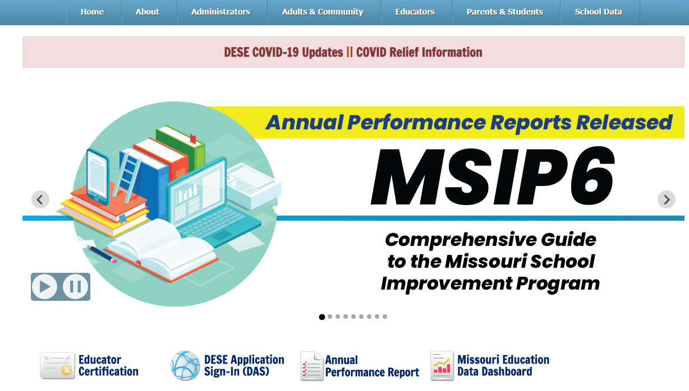
Navigating to the VLP
Go to the DESE Home page (dese.mo.gov) and select the DESE Application Sign-in Icon
DESE Home page dese.mo.gov
Or select the “Educators Tab” and select DESE Application Sign-In (DAS) from the list under “Popular Services”
Notes:
Say: From DESE’s Home page, go to www.dese.mo.gov. Hover over EDUCATORS, and then select DESE Application Sign-in. Or select the DESE Application Sign-In (DAS) Icon Button on the home page under the announcements.

Slide 4
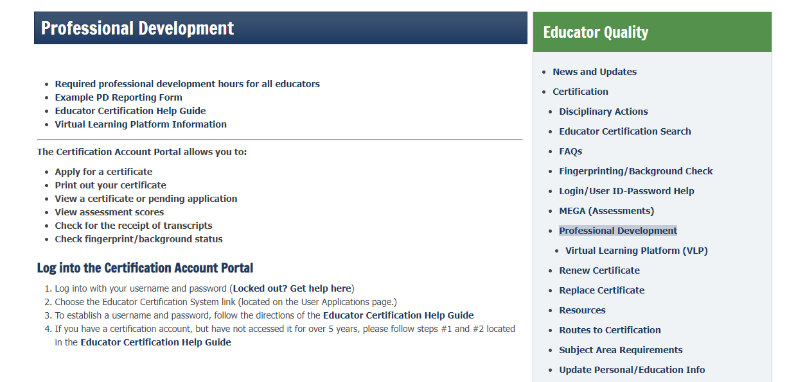
Navigating to the VLP
Notes:
Say: Another way is from our NEW VLP Information page on the DESE Website. Hover over Educators, then select Professional Development. Select either Virtual Learning Platform information under the Professional Development Header, or Virtual Learning Platform (VLP) under the Educator Quality Header

Slide 5
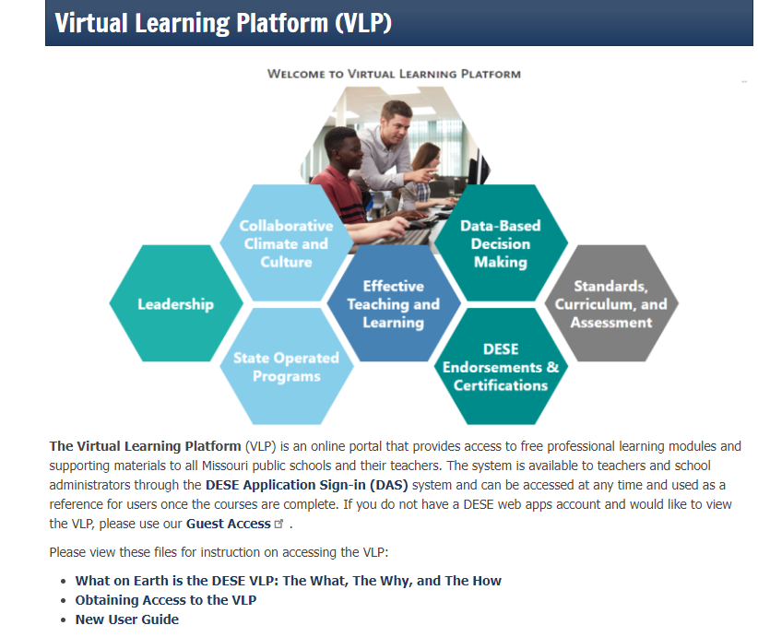
DESE VLP Webpage
Notes:
Say: This page provides a link to the DESE Application Sign-in to take you directly to the VLP, and a Guest link to allow folks to take a look before creating a DAS account. This page also has documents, including this power-point to help users understand the purpose of the VLP, Obtain Access, and a Guide on how to use the VLP once they get in.

Slide 6
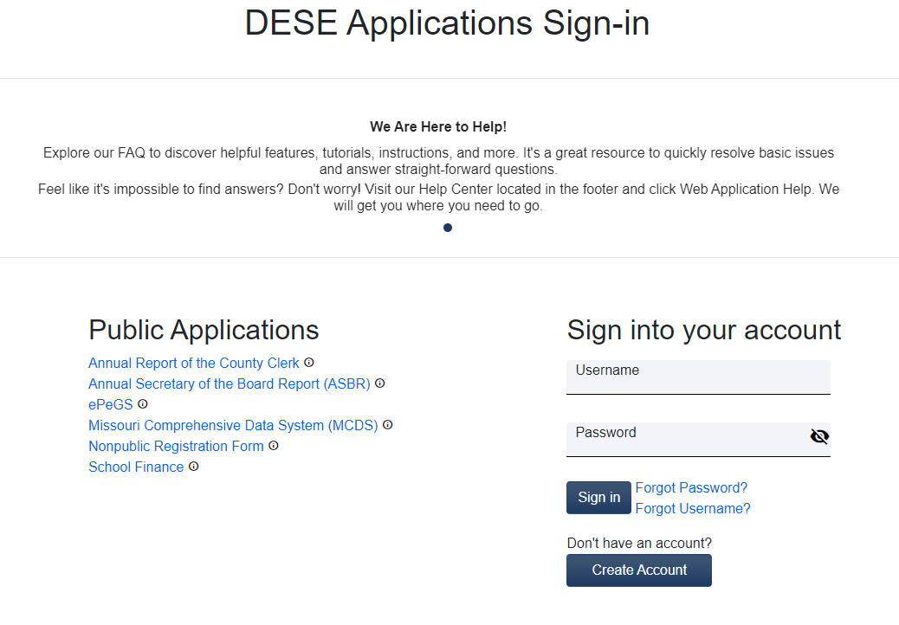
Navigating to theVLP
Then log on with your web application user name and password.
Notes:
SAY: Sign-in to your account.
NOTE: Districts must set up their personnel in the VLP before they have access to the modules. Users must create a DAS account to get access and be set up in the VLP by their Administrators.

Slide 7
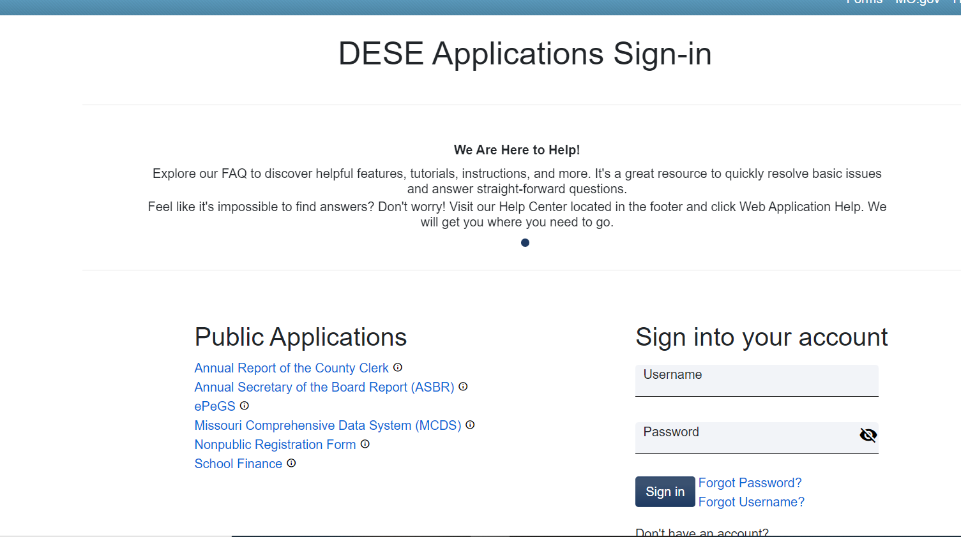
Navigating to VLP

Slide 8
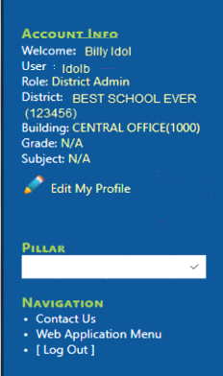
User Profile
Account Info:
Displays the user account information, the district, and building linked to the account. To modify the user information, click the “Edit my Profile” link to edit the user information.
Navigation:
Quick links to:
Send correspondence to the DESE VLP Team,
Return to the Web Application Menu page,
Log Out of VLP and Web Applications

Slide 9
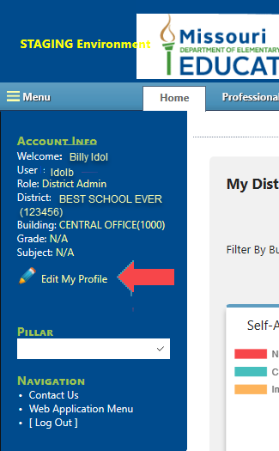
Editing User Profile
To edit the district’s profile – first click on Edit My Profile

Slide 10
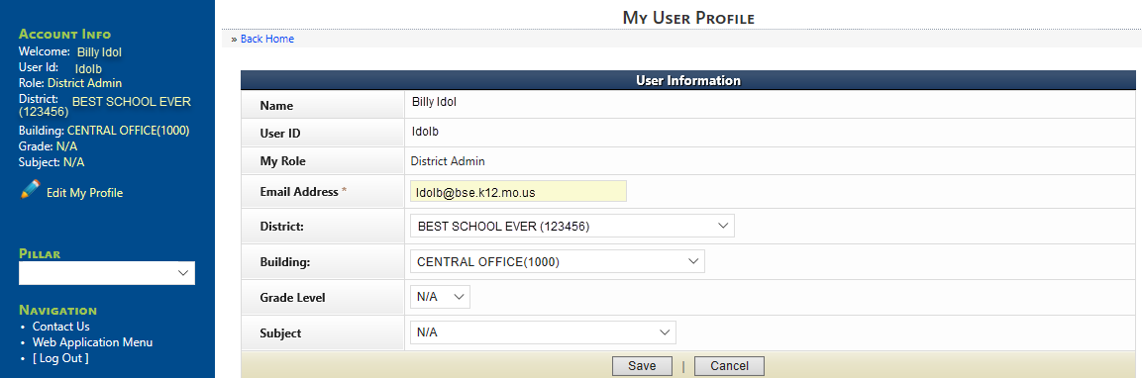
Editing User Profile
This will take the user to User Information where they may edit any details needed and then click save.

Slide 11
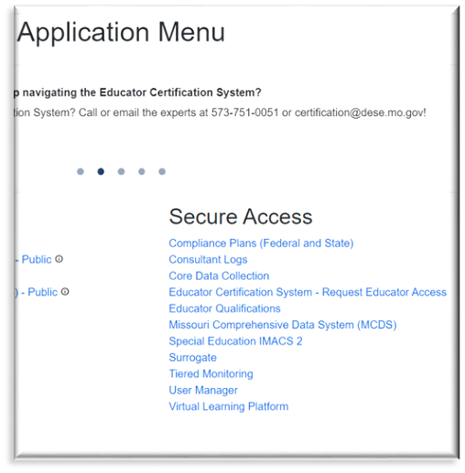
Navigation
Other options in the Navigation section:
Contact Us – will bring up email program
Web Application Menu- will take you back to the DESE Web Applications menu

Slide 12
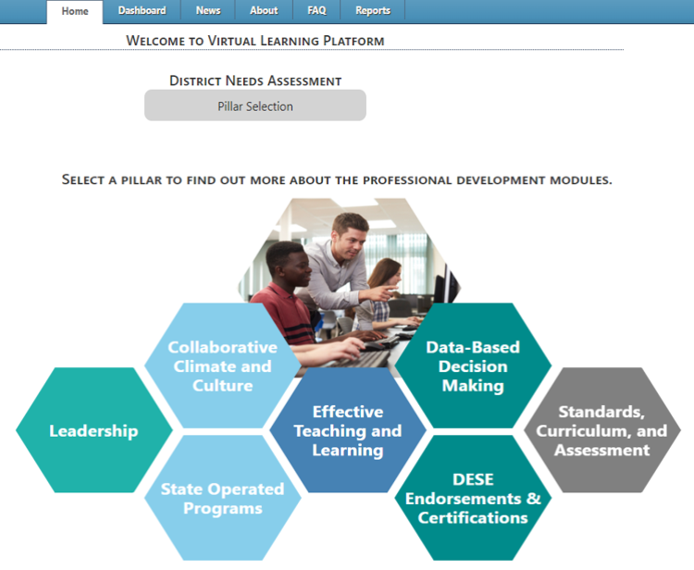
VLP Homepage
Home – directs the user to the homepage where users may access the Pillars of the Virtual Learning Platform.
Dashboard – Users will be able to access the different Pillars, Professional Learning Modules, and Assessments from the dashboard.

Slide 13
VLP Homepage
About - This is were details about the VLP application can be found.
News - this page will display updates or system information.
Notes:
The about section has information currently regarding the VLP, and our DESE Endorsed Certification Program MOPAL.

Slide 14
VLP Homepage
FAQ – This page is a quick reference for users to get answers to some common questions, and how-to guides.
Reports – This page allows the user to generate the reports available to them, and to print transcripts.
Notes:
We now have new FAQ files that are available to view and download.

Slide 15
Accessing Pillars
Users will access the Pillars of VLP by clicking the tiles on the home page.

Slide 16
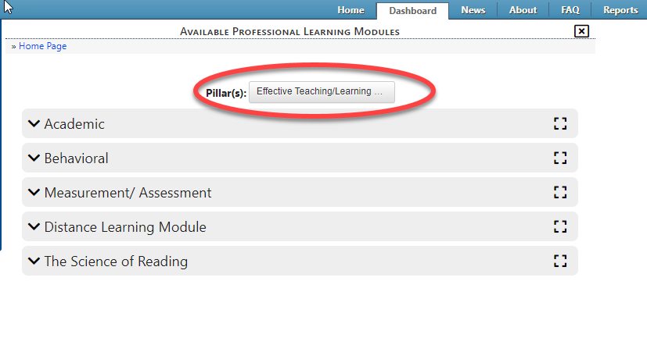
Accessing Pillars
Accessing Pillars
The user can then access Professional Learning Modules (PLMs) from this page or change the pillar and access other PLMs.

Slide 17
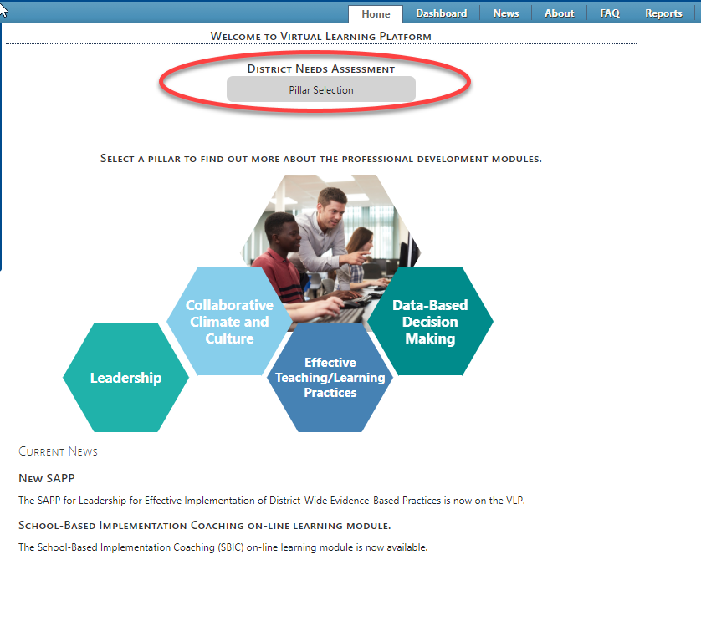
Accessing Pillars
District Needs Assessment
Clicking “Pillar Section” at the top of the screen takes you to the District Needs Assessment.

Slide 18
District Needs Assessment
District Needs Assessment
On this page the user can expand the pillars to review and print the Needs Assessment Pillar questions and guidance.

Slide 19
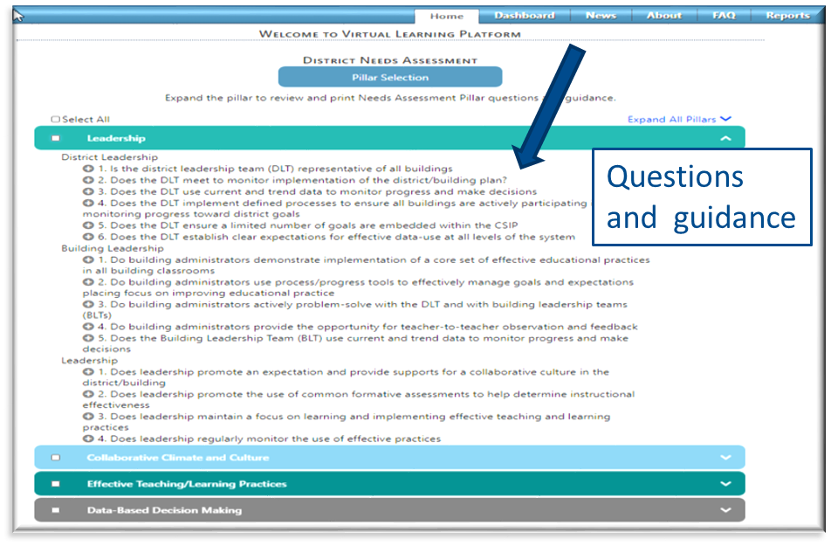
District Needs Assessment
Click the arrow to expand the pillar to show questions and guidance.

Slide 20
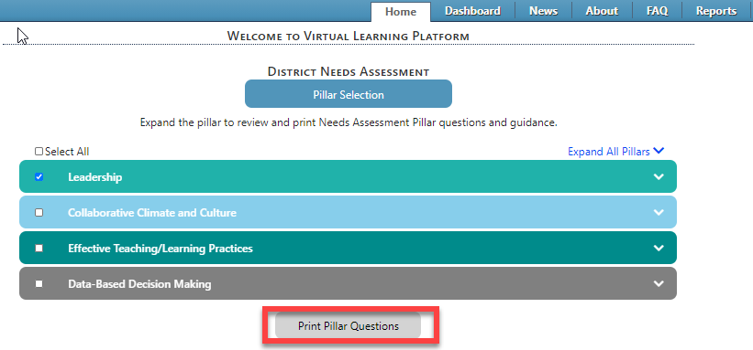
District Needs Assessment
Select the pillars and print the District Needs Assessment Questions, by clicking the gray “Print Pillar Questions” at the bottom of the screen.

Slide 21
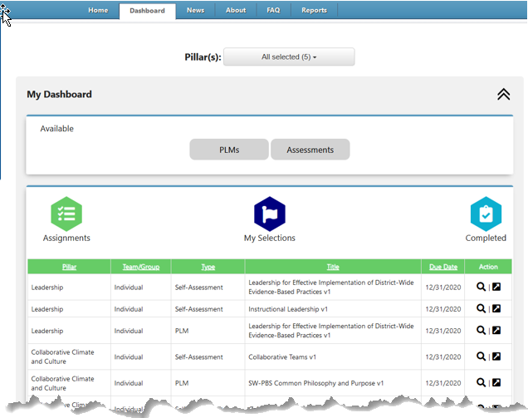
Understanding the Dashboard
From this page users can view their PLMs or Assessments.
There are three categories: Assignments, My Selections, and Completed.

Slide 22
Understanding the Dashboard
When the user clicks on Assignments the heading will turn green and they will be able to see all PLMs and Self-Assessments assigned to them.

Slide 23
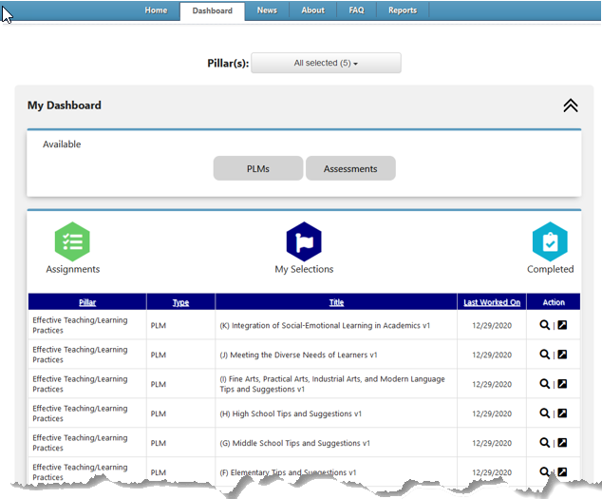
Understanding the Dashboard
When the user clicks on My Selections the heading will turn dark blue and show PLMs or Self-Assessments that the user has worked on.

Slide 24
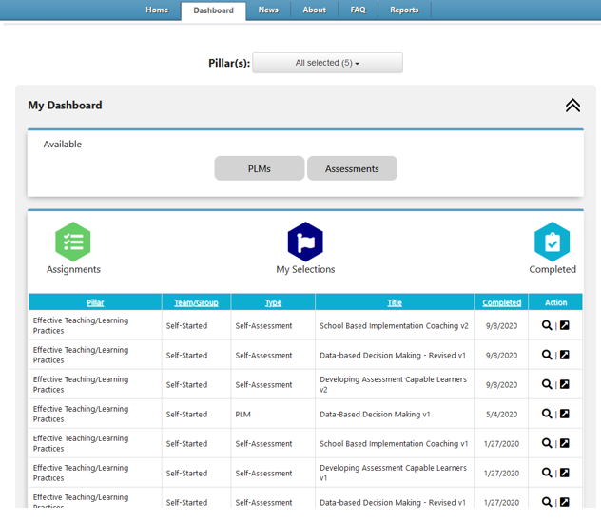
Understanding the Dashboard
When the user clicks on Completed the heading will turn light blue and show PLMs or Self-Assessments that the user has completed.

Slide 25
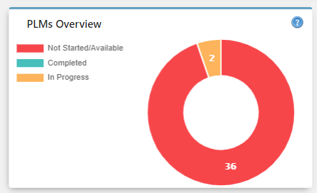
PLMs Overview
PLMs Overview
This box is a graphic of the Professional Learning Modules (PLM) overview. The PLMs will be represented in the graph as the user progresses.
Red represents any PLMs that are available in the VLP that the user has not started.
Blue represents any PLMs that have been completed.
Yellow represents any PLMs that are currently being worked on, but have not been completed.

Slide 26
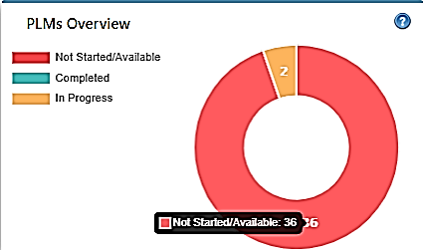
PLMs Overview
PLMs Overview
Using the cursor, hover over the color in the graph to display the PLM count associated with that color.

Slide 27
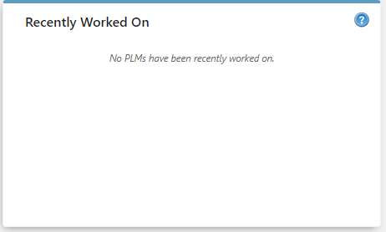
Recently Worked On-PLMs
The next display box will be the recently worked on PLMs. This box will remain blank until a PLM has been started.

Slide 28
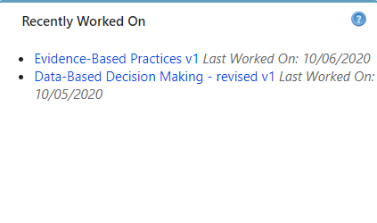
Recently Worked On-PLMs
Once an PLM has been started, the title will display with a link to the PLM.
This page will display either a status of “Last Worked On:” if the user has not completed the PLM or,
“Completed” with the corresponding date that the user completed it.
To continue the PLM or return to a completed PLM, click the link to access the PLM. The Recently Worked On box will display up to the five of the most recently worked on PLMs.

Slide 29
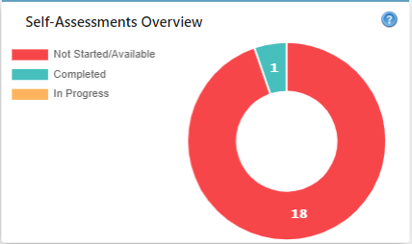
Self-Assessments Overview
Self-Assessments Overview
The next display box is a graphic of the Self-Assessments. The assessments will be represented in the graph as the user progresses.
Red represents any assessments that are available in the VLP that the user has not started.
Blue represents any assessments that have been completed.
Yellow represents any assessments that are currently being worked on, but have not been completed.

Slide 30
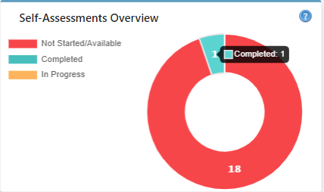
Self-Assessments Overview
Self-Assessments Overview
Using the cursor, hover over the color in the graph to display the assessment count associated with that color.

Slide 31
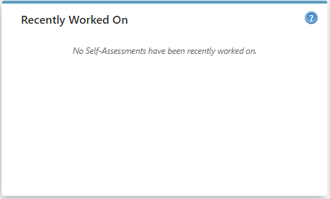
Recently Worked On-Self-Assessments
Recently Worked On-Self-Assessments
The next display box will be the recently worked on assessments. This box will remain blank until an assessment has been started.

Slide 32
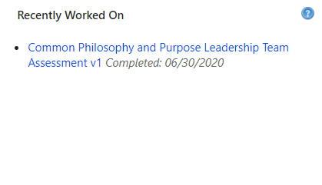
Recently Worked On-Self-Assessments
Recently Worked On-Self-Assessments
Once an assessment has been started, the title will display with a link to the assessment.
This page will display either a status of “Last Worked On:” if the user has not completed the assessment or,
“Completed” with the corresponding date that the user completed it.
To continue the assessment or return to a completed assessment, click the link to access the assessment. The Recently Worked On box will display up to the five of the most recently worked on assessments.

Slide 33
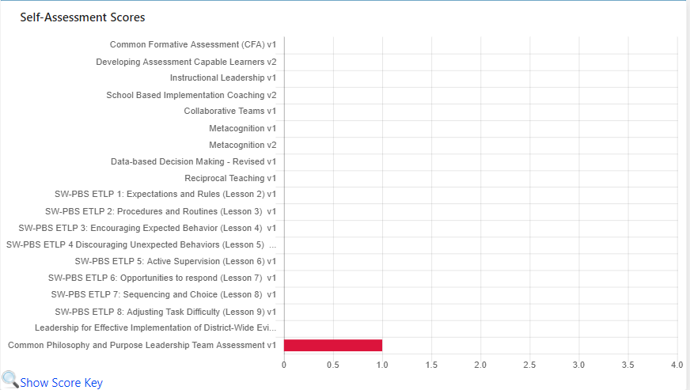
Self-Assessment Scores
Self-Assessment Scores
Continue scrolling down the page to access the Self-Assessment Scores bar graph. This graph will display the most current score for the individual Self-Assessment once an assessment has been completed.

Slide 34
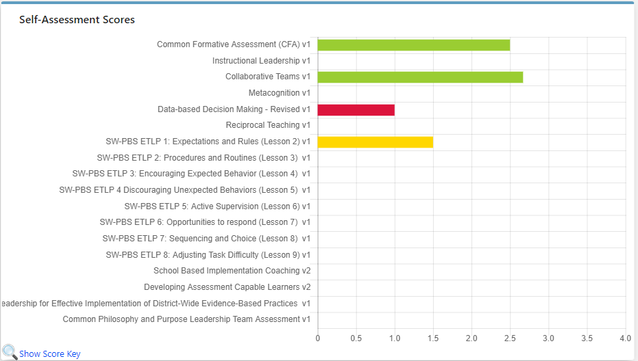
Self-Assessment Scores
The most recent score for the corresponding self-assessment will be displayed in the bar graph. The color of the bar will be reflective of the score received on the self-assessment.
Blue = Exemplary, Green=Proficient, Yellow=Close to Proficient, Red=Far from Proficient.

Slide 35
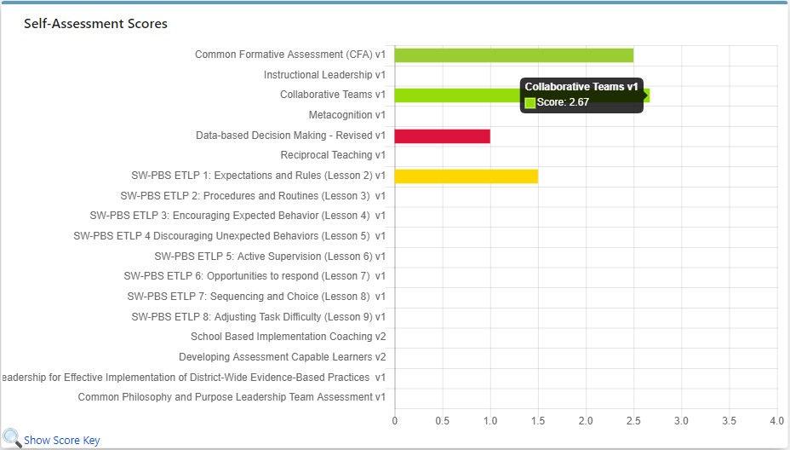
Self-Assessment Scores
To display the score for a specific assessment, use the cursor to hover over the colored bar of the corresponding assessment.

Slide 36
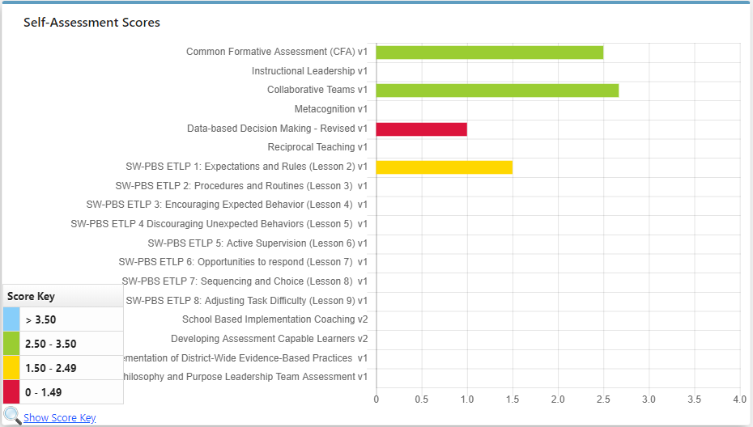
Self-Assessment Scores
To display the score key, use the cursor to hover over “Show Score Key” at the bottom of the graph.

Slide 37
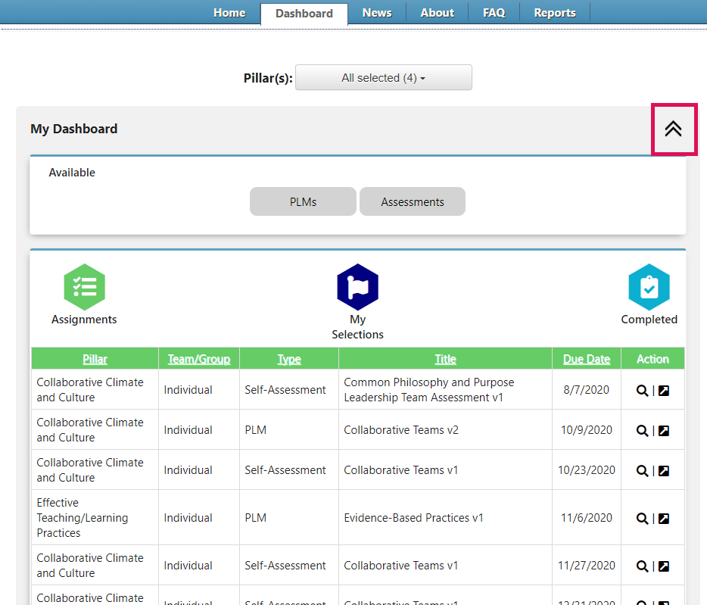
Collapsing the Dashboard
To hide the dashboard, select the double arrows at the top of any section on the Dashboard page. This will collapse that specific section, but leave other sections open.

Slide 38
Collapsing the Dashboard
To expand the dashboard, select the same double arrows that were selected to collapse the dashboard.

Slide 39
Virtual Learning Platform
573-522-3489
Missourisystemsofsupport@dese.mo.gov

