Slide 1
Virtual Learning Platform Creating Yearly PD Assignments
September 28, 2022

Slide 2
Welcome
Welcome to the Virtual Learning Platform (VLP)
The following step-by-step information will provide guidance on creating Yearly PD assignments within the VLP.

Slide 3
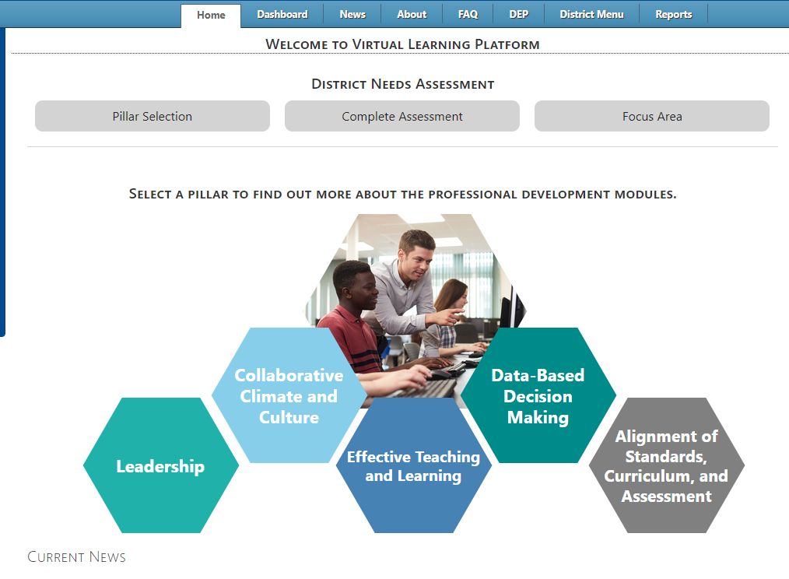
Home
Upon logging in to the Virtual Learning Platform (VLP), the first landing page will be the “Pillar Selection” under the Home tab. To create an assignment, select the “District Menu” tab at the top of the page.

Slide 4
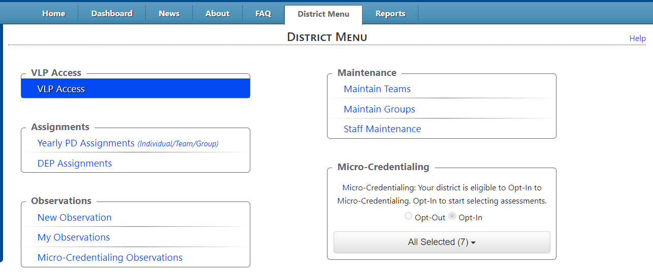
Yearly PD Assignments
Once on the “District Menu” page, under the Assignment box, select “Yearly PD Assignments”.

Slide 5
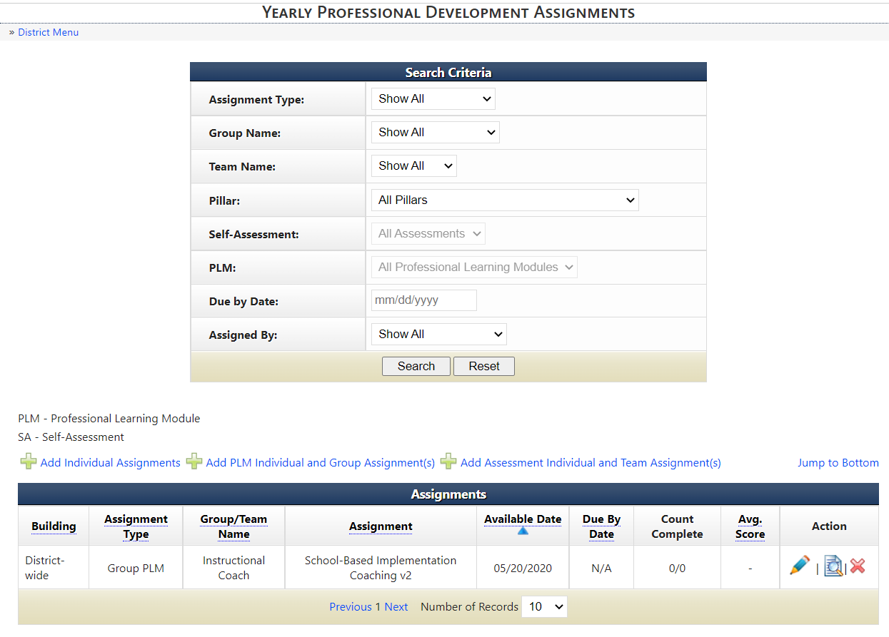
Adding Assignments
To add an assignment, which is assigning a Professional Learning Module with the corresponding assessment within one box, select the “Add Individual Assignment” link.
This will allow you to assign a PLM or a Self-Assessment.

Slide 6
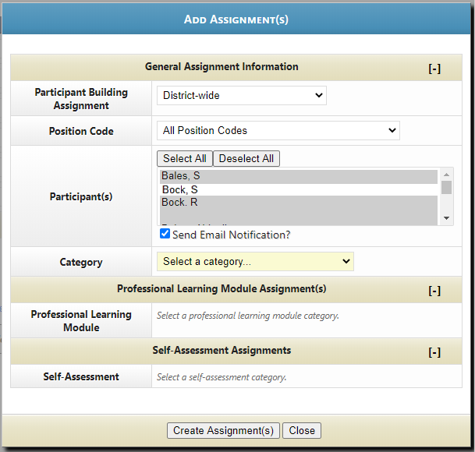
Adding Assignments
Using the dropdown, select the building of the team to be created. If the team spans across multiple buildings, a “District” option is available.
To filter users by position codes, use the “Position Code” drop down.
Select participant(s) for the assignments. Users that have been selected will be highlighted in grey.
Note: A yellow box denotes a required field.

Slide 7
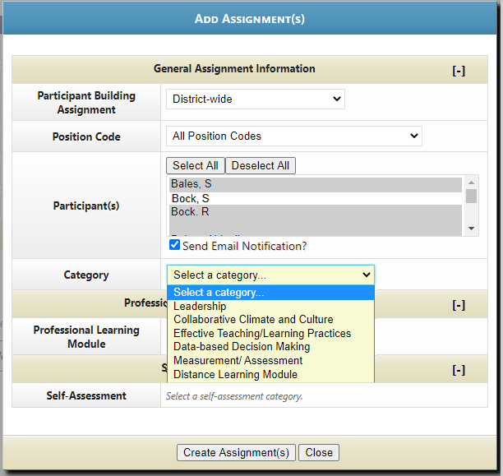
Adding Assignments
To select the category of the assignment, click the Category drop down. This will display the list of available categories to select. Once the selection has been made at the category level, the below selections will filter to available PLMs and Self-Assessments in that category.
Note: A yellow box denotes a required field.

Slide 8
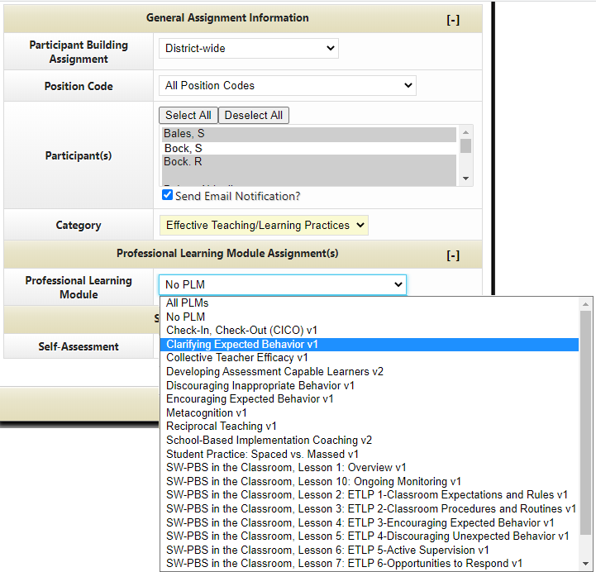
Adding PLM Assignments
To select the Professional Learning Module from the category entered above, select the Professional Learning Module title.

Slide 9
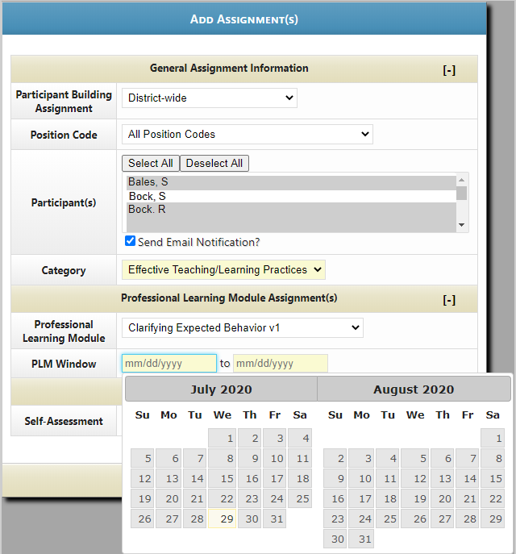
Adding PLM Assignments
Select the PLM window date. The PLM Window is a set of dates selected that the participant can complete the assigned PLM within. If the participant does not complete the PLM within the dates selected, the participant will only be able to access the PLM independently. The progress made from the independent selection will NOT count towards the assignment.

Slide 10
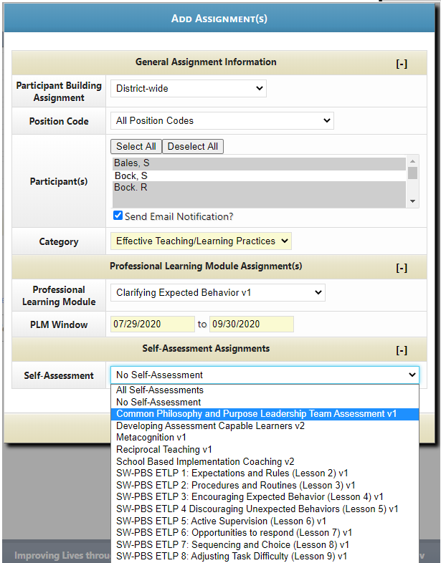
Adding Self-Assessment Assignments
To select a Self-Assessment that corresponds with the category and/or Professional Learning Module, use the Self-Assessment drop down.
Note* The self-assessment drop down does not filter out of the Professional Learning Module selection. The available self-assessments will filter from the Category selection.

Slide 11
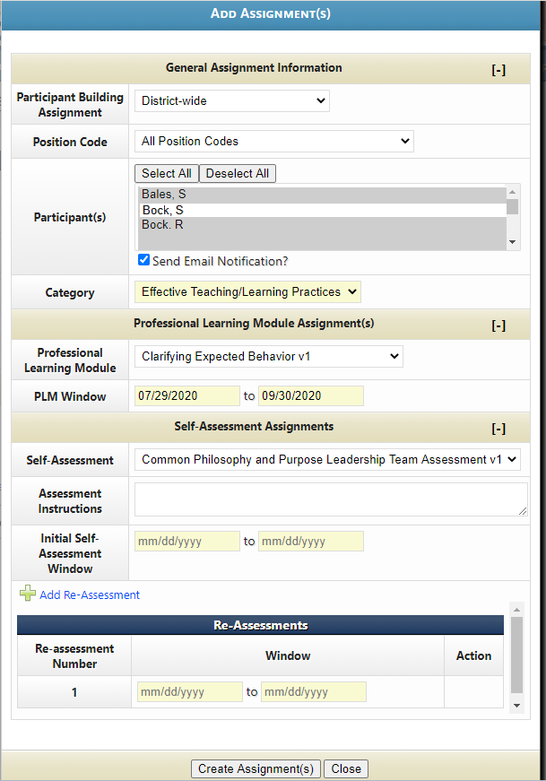
Adding Self-Assessment Assignments
Select the Initial Self-Assessment window. The Initial Self-Assessment Window is a set of dates selected that the participant can complete the initial assigned assessment within. If the participant does not complete the initial assessment within the dates selected, the participant will only be able to access the assessment independently. The progress made from the independent selection will NOT count towards the assignment.

Slide 12
Adding Self-Assessment Assignments
After selecting the initial Self-Assessment window, select the Re-Assessment window dates. To add multiple re-assessments through multiple date ranges, select the “Add Re-Assessment” link. Add 1 to many re-assessments.

Slide 13
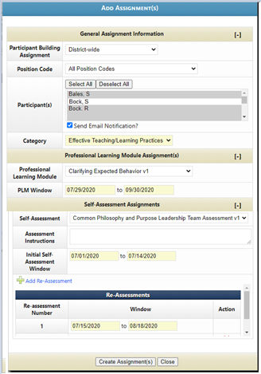
Create Assignment
To save the assignment, click “Create Assignment(s)” at the bottom of the pop-up box. To cancel the assignment and remove all progress made, select the “Close” button.

Slide 14
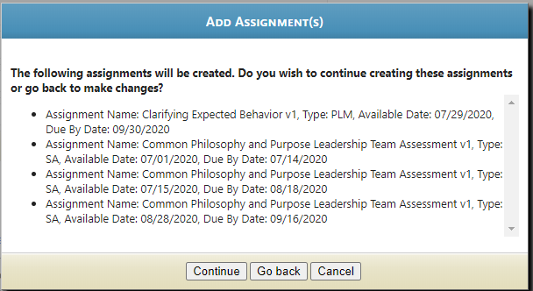
Create Assignment
After selecting the “Create Assignment” button, another pop-up box will appear.
After reviewing, select the following options:
Continue-This will save the assignment and continue to the next page.
Go back-This will direct you back to the assignment page to make changes
Cancel- cancel the assignment and remove all progress made.

Slide 15
Yearly Professional Development Assignments
After selecting continue, the assignment will appear on the Yearly Professional Development Assignments page.
The assignments will appear as individual portions under assignment type.
SA stands for Self-Assessment portion of the assignment.
PLM stands for Professional Learning Module portion of the assignment.

Slide 16
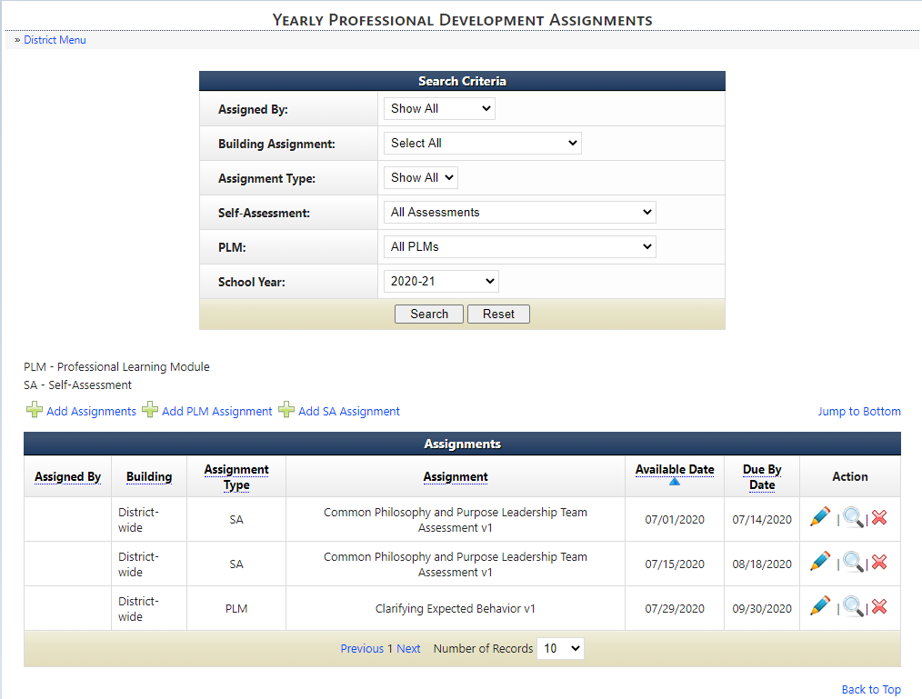
Yearly Professional Development Assignments
To edit the assignment instructions or assignment window, select the Pencil icon. This will provide a pop-up directly on the page for editing.
To view/edit participants, select the magnifying glass icon.
To delete the assignment, select the red “X” icon.

Slide 17
Virtual Learning Platform
573-522-3489
MissouriSystemsofSupport@dese.mo.gov

